Slide 1

Scale articulation
Prof.dr.ir. Taeke M. de Jong
Rīga Masterclass October 27th 2014

Slide 2
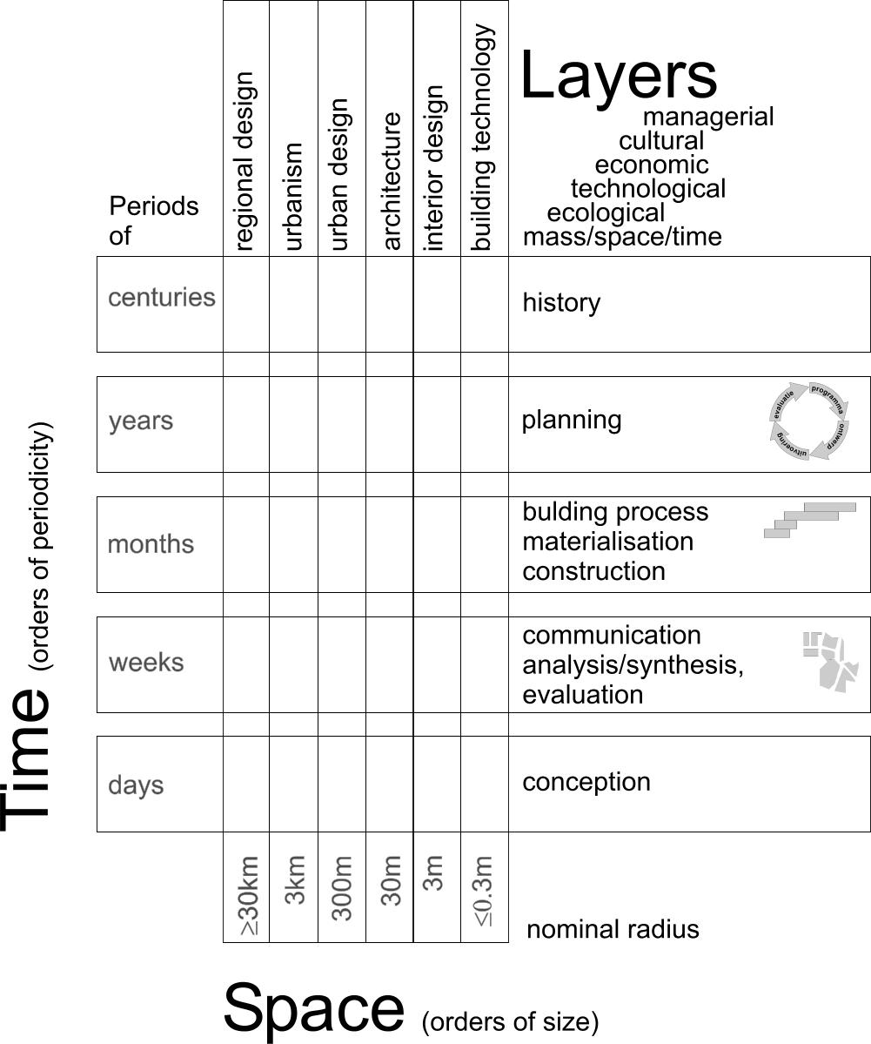
The domain of Urban and Architectural design
Imagine a school with elevators and corridors leading you through different spatial levels, time-spans, and layers of design.

Slide 3
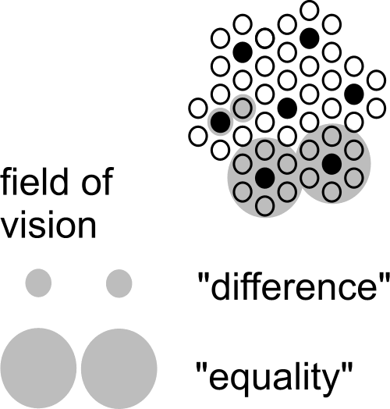
A scale paradox, its factor 3
Any conclusion about space is scale-sensitive.
It can change into its opposite already with a factor 3 of scale.

Slide 4
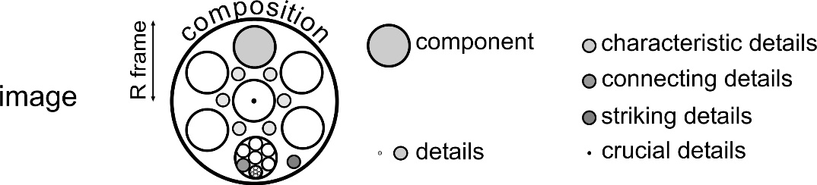
Ten levels of difference to be explored
Look for differences at any level of scale

Slide 5
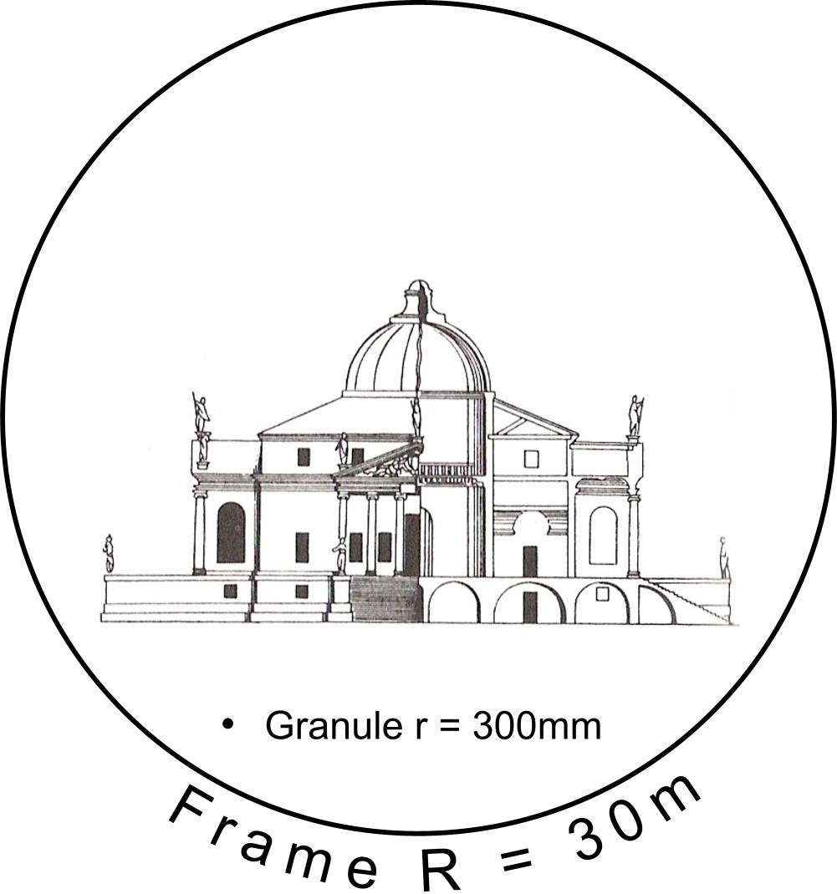
A frame 100x the grain of a drawing representing a building
Any representation has an upper and a lower boundary:
a frame and a grain.
Let us notate them as a ‘nominal radius’ R and r.

Slide 6
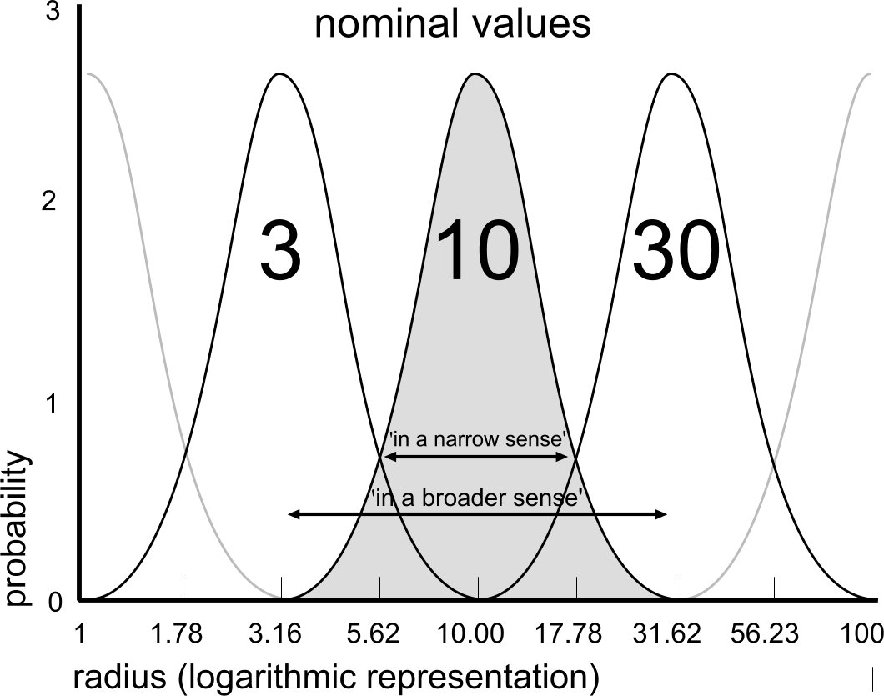
Boundaries of nominal R and r
A ‘nominal’ radius is a name for a range of measures.
‘R=10m’ is something between 3m and 30m.

Slide 7
Usual names fitting R=

Slide 8
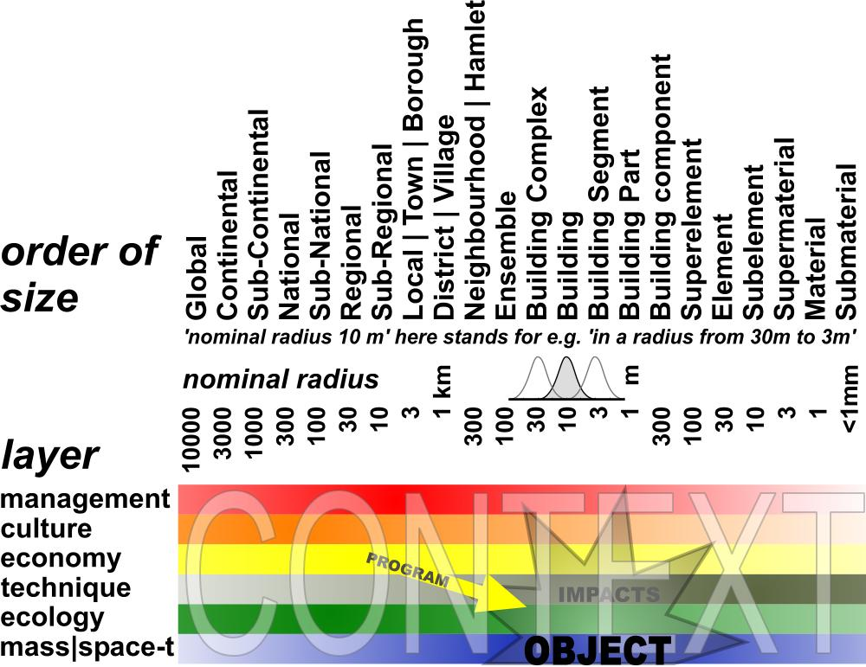
Object in Context (months, years)
Any object has impacts in different layers of context at different levels of scale.
A programme is simply a set of intended impacts.

Slide 9
Ten levels of difference to be explored
Look for differences at any level of scale

Slide 10
Content diversifies space
Some values of named variables may serve as legend units.

Slide 11
  Form distributes content in space

Slide 12
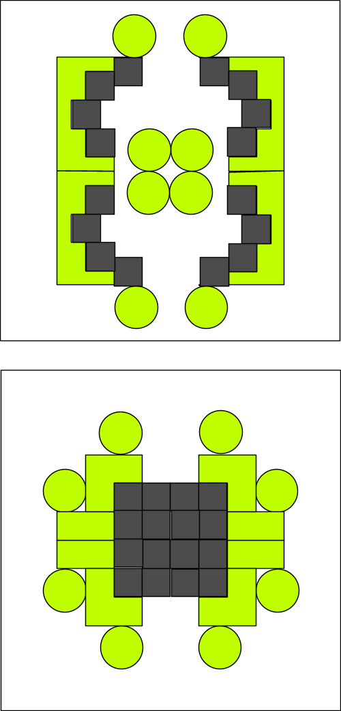
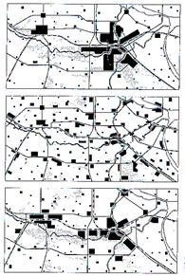
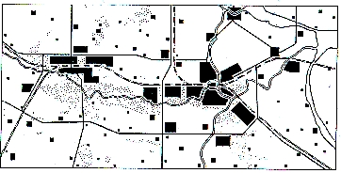
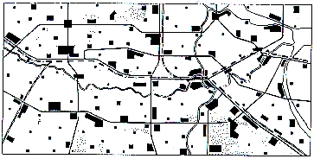
Form = state of distribution
Accumulation
Deconcentration
Concentration
Sprawl

Slide 13
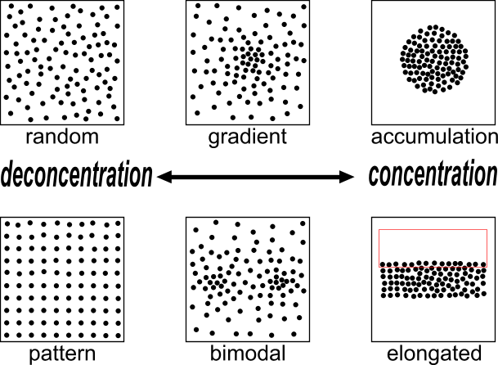
States of distribution of 100 dots
Any shape appears between total sprawl and total accumu-lation

Slide 14
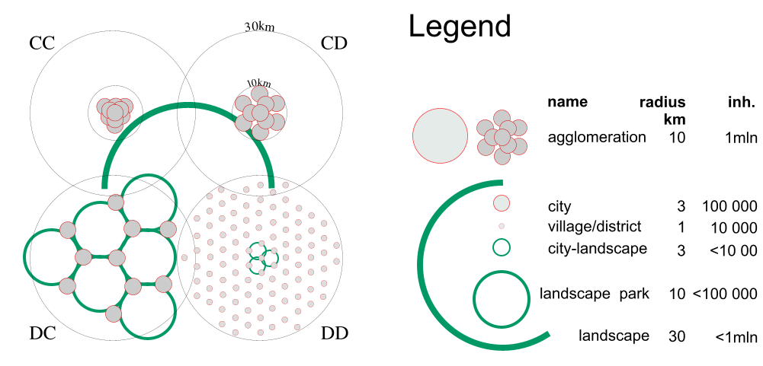
Concentration and Deconcentration at 2 levels ...
… result in accumulation and sprawl
at different levels of scale.

Slide 15
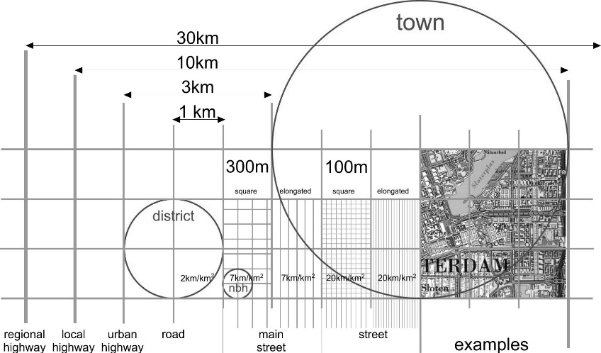
Structure stabilises form

Slide 16
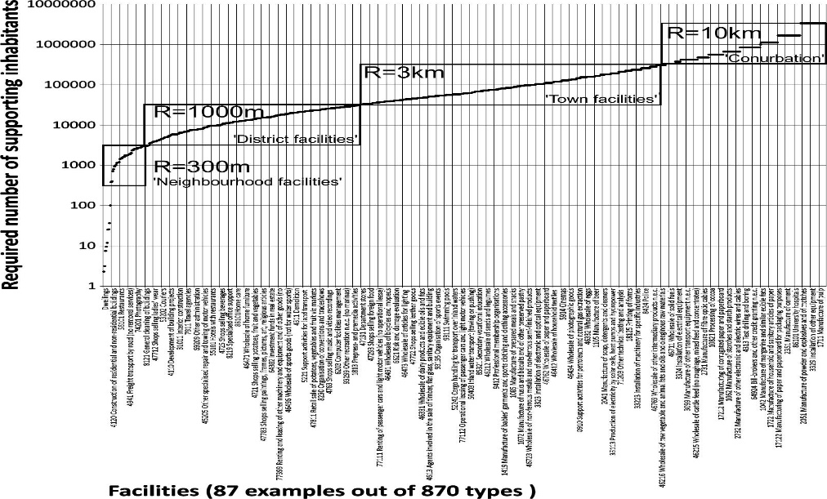
Functions at different levels of scale

Slide 17
Intentions about the object in its context
Stakeholders, specialists and users can be located on scale and layer.
Ask them to specify the intentions and expectations in their position.

Slide 18
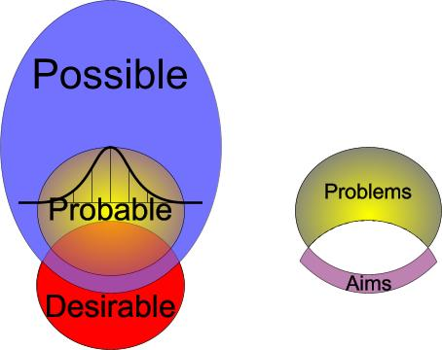
Intentions and expectations are different modes of thinking

Slide 19
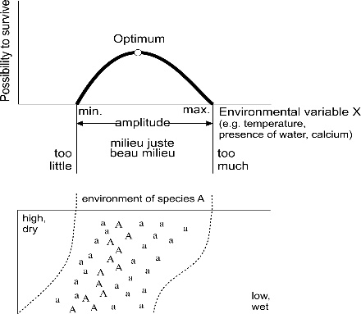
What is spatial quality?

Slide 20
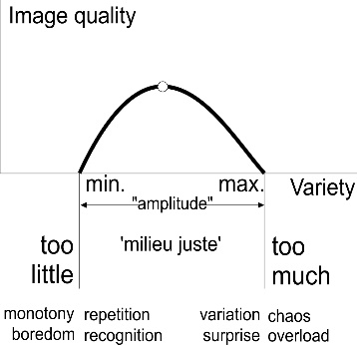
Quality as a function of variety

Slide 21
Variety in modes, orders, levels and layers
modes | orders | levels | layers
probable | intention | … | managerial
possible | function | 1mm | cultural
imaginable | structure | … | economic
 | form | 1m | technical
desirable | content | 3m | biological
 |  | 10m | physical
 |  | …

Slide 22
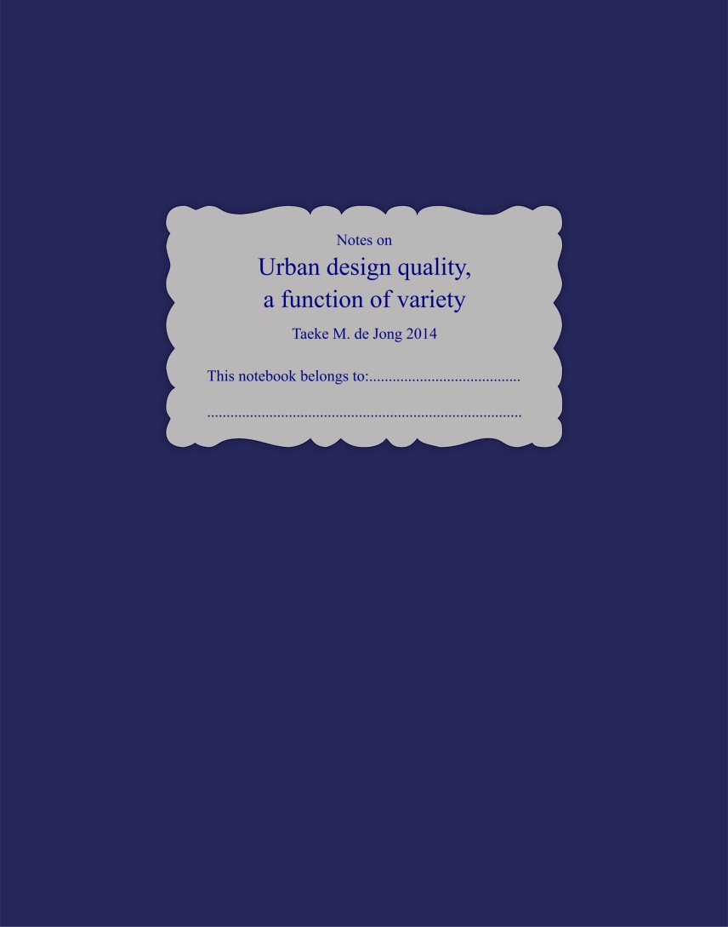
Further reading
€5,-

Slide 23
Exercise 1: R=100m ensemble form
Prof.dr.ir. Taeke M. de Jong
Rīga Masterclass October 28th 2014

Slide 24
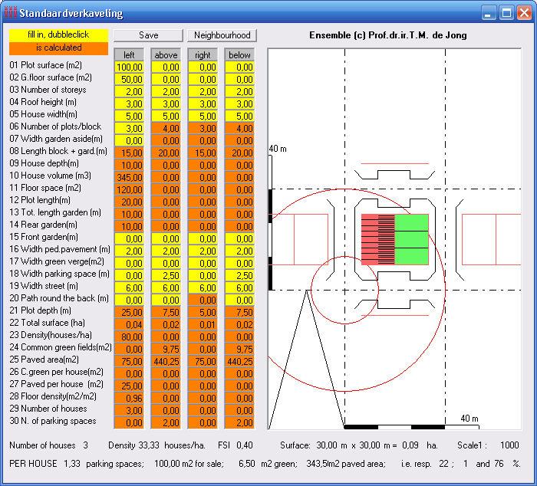
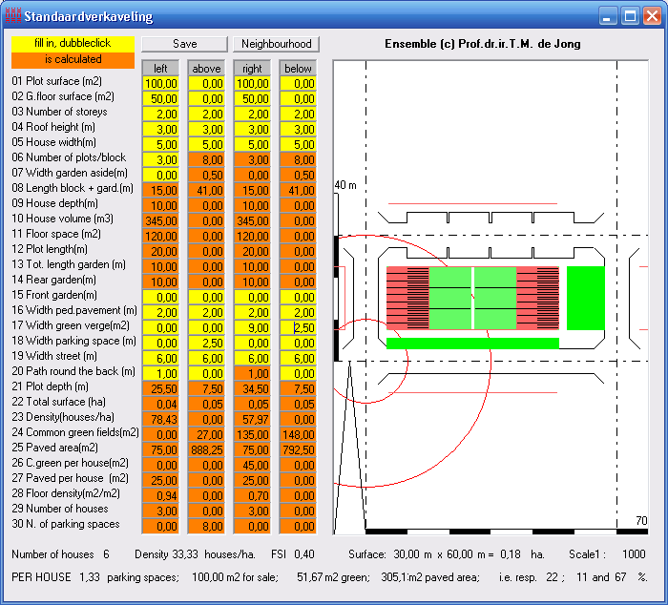
  Mirroring the smallest urban island
30x30m
30x60m W-E mirroring
76% public pavement
67% public pavement
Notes:
Fig. 19 grid measure of 30x30m.
excessive surface of public pavement (here 76%!),
leaving relatively little for sale (here maximally 22%) paying for that public space.
Fig. 20 30x60m W-E mirroring
W-E mirroring elongates the urban island reducing public pavement (here into 67%).
The gained surface: a green margin of 9m drawn East and 2.50m drawn South:
one side with parking places is enough to reach more than 1 parking place per dwelling.
The shadow of the N side is best suitable for parking.
W and E roads are used for entrance to houses at both sides and back gardens get more privacy.
The lots for sale differentiate in morning~ and evening sun lovers.

Slide 25
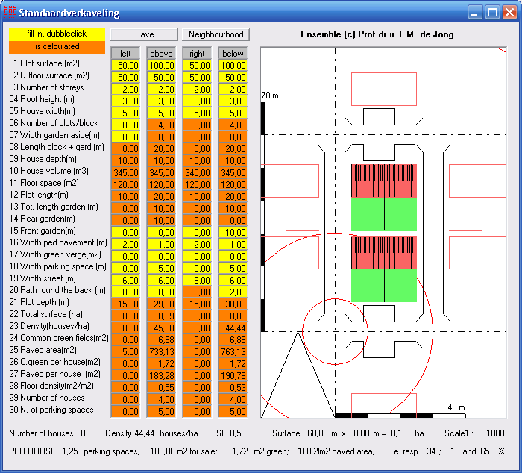
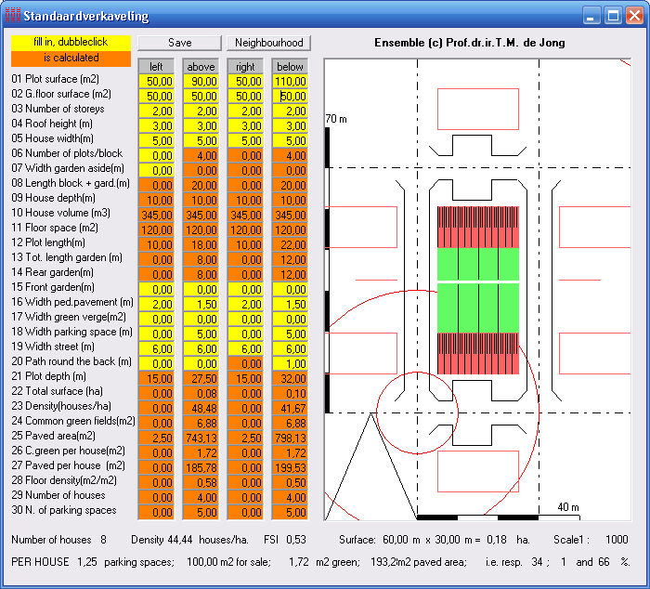
  Taking sun into account
60x30m N-S Turning and repeting
60x30m N-S mirroring
65% public pavement
66% public pavement
Notes:
Fig. 21 60x30m N-S Turning and multiplying
South gardens.
short sides used for parking, forcing cross-parking to reach >1 parking places per dwelling.
The path round the back enlarged at the expense of sidewalks to give proper front access to the Southern block.
Fig. 22 60x30m N-S mirroring
North gardens, drawn longer here to get a partly sunny view on the N garden still.
It differentiates the lots for sale in size
suggests a different dwelling type for sun lovers with south gardens and
artistic life style with Northern light rooms such as studios.

Slide 26
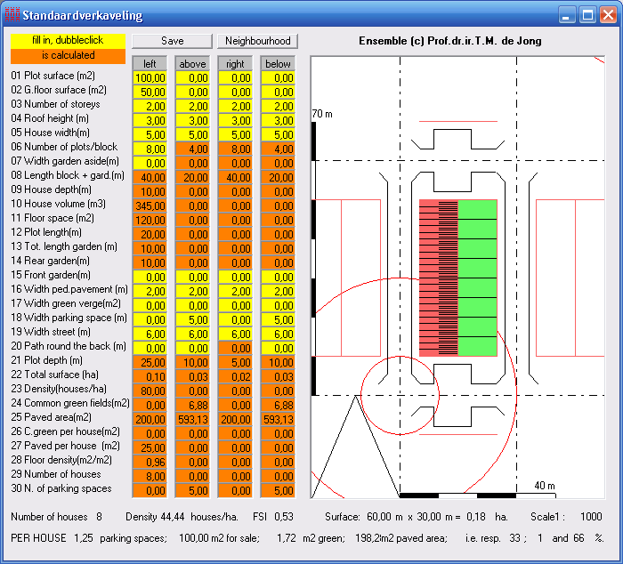
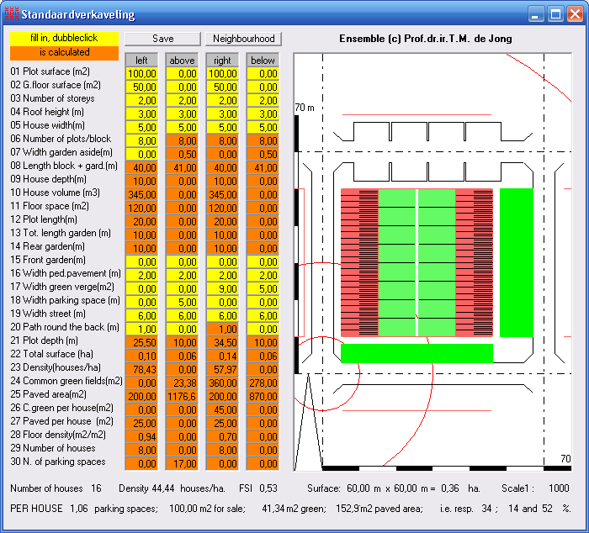
  Elongating
60x30m elongating
60x60m mirroring
66% public pavement
52% public pavement
Notes:
Fig. 23 60x30m elongating
one sided elongating avoids the path round the back utilizing the side walk, giving back a proper size to the sidewalks N and S.
East gardens are suitable for people who prefer morning sun in the garden and in the sleeping room.
Pavement is still 66%.
Fig. 24 60x60m mirroring
Mirroring gives evening people a chance
both gardens more privacy.
It differentiates use and plantation.
The enlargement of the urban island again reduces the amount of pavement, now into 52%
in favour of the margins possibly used as green area: 9m East and 5m South.

Slide 27
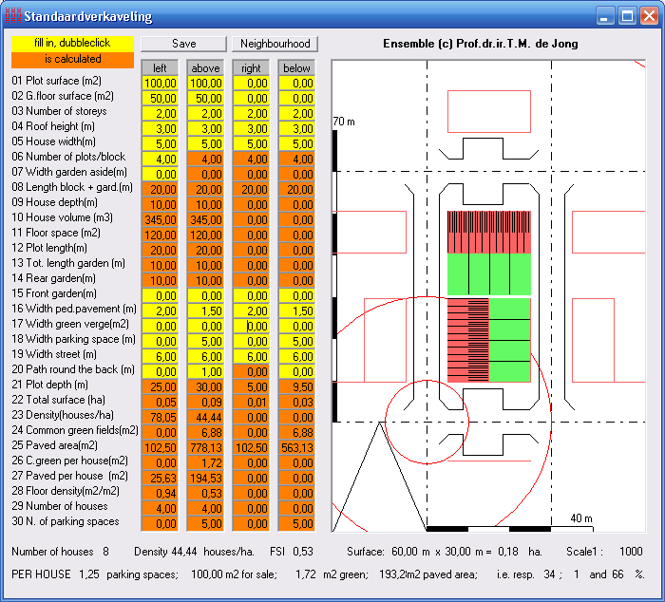
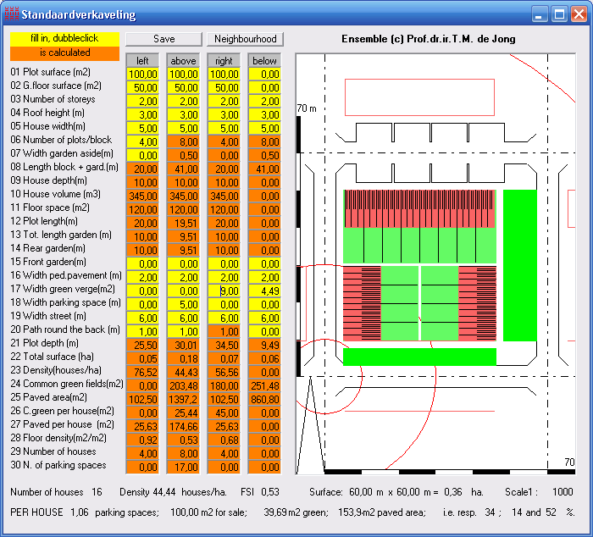
  L-shape and U-shape
60x30m L-shape
60x60m U-shape
66% public pavement
52% public pavement
Notes:
Fig. 25 60x30m L-shape
perpendicular blocks provide streetcorners with front entrances in 2 directions.
urban look and safety by private control of public space on both roads involved.
design solutions for corners, not implemented here
struggle with smaller or no gardens in the corner.
Fig. 26 60x60m U-shape
U-shaped allotments with one open side, here avoiding North gardens.
reducing pavement from 66% into 52%
green margins of 9m East and 5m South.
S gardens go 0.5m around the back now, giving space for ivy-covered side façades avoiding grafitti.

Slide 28
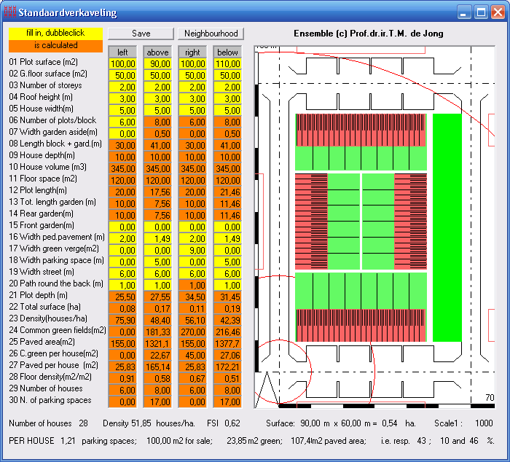
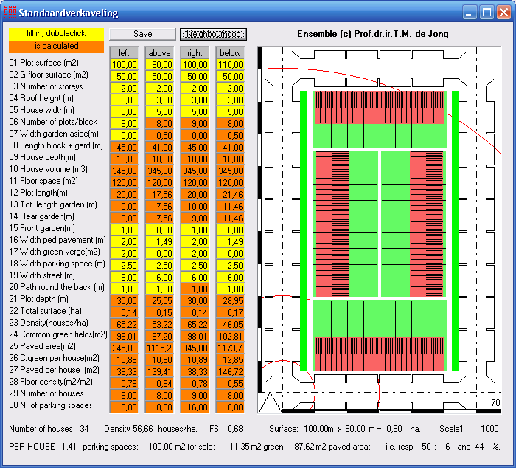
  Closed urban islands
90x60m Closing
100x60m Elongating and adapting
46% public pavement
44% public pavement
Notes:
Fig. 27 90x60m Closing
a usual allotment type of 90m length, leaving a 9m green margin East to fill the urban grid of multiples by 30m.
Limiting parking places to N and S urges cross parking
little space for sidewalks.
Fig. 28 Elongating and adapting 100x60m
elongating to 100m is easy by adding 2 houses West and East.
shortage of parking places then forces parking at all sides.
giving up cross parking N and S, there is space for 6 extra houses in total.
The reduction of pavement is 2% only, but the number of parking places is 1.4 per dwelling.
the green margin is distributed W and E to make trees possible.

Slide 29
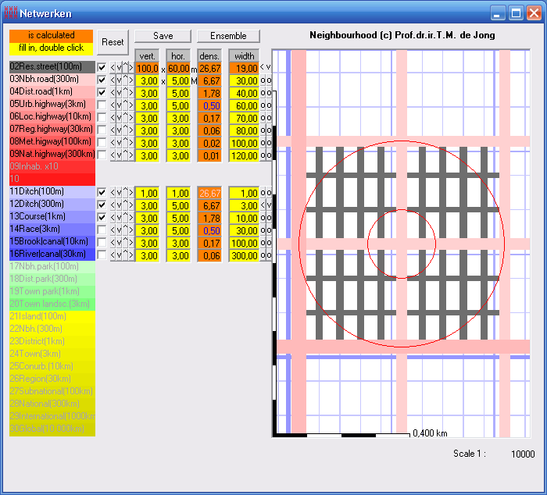
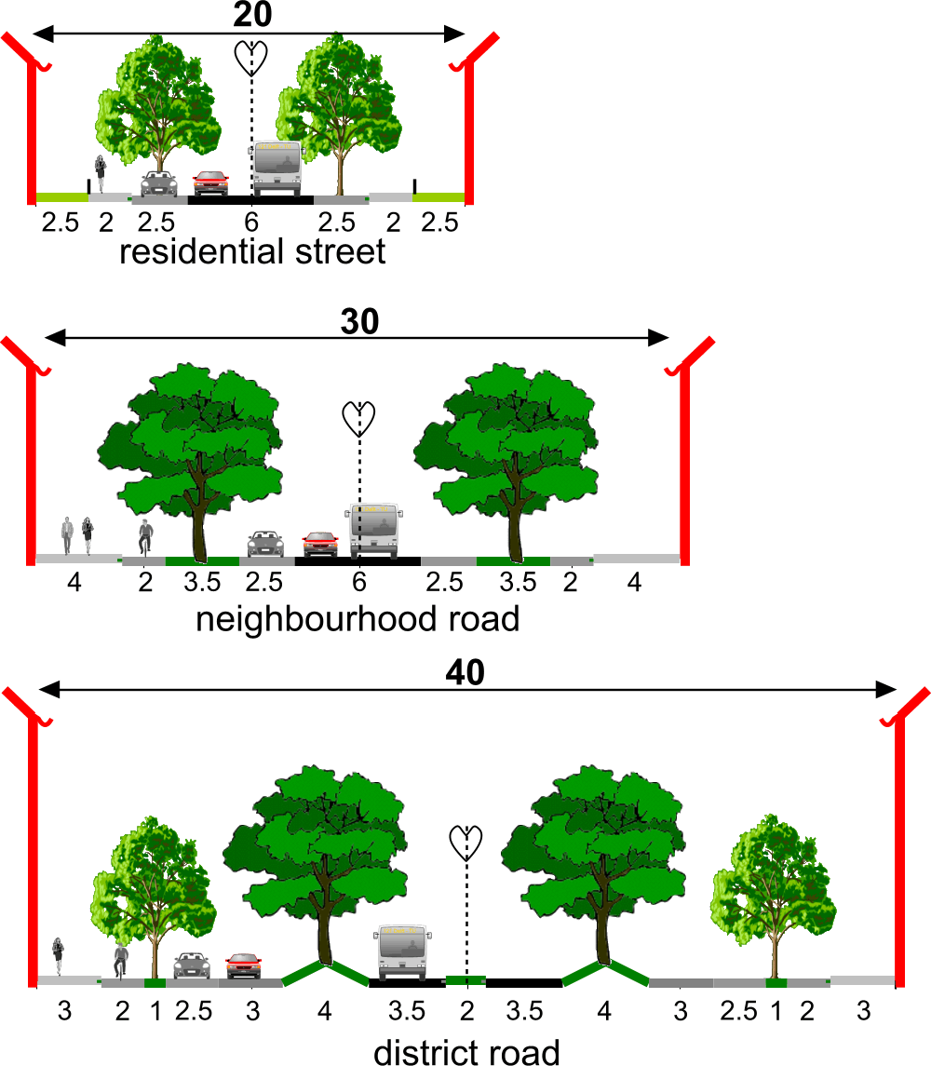
  A neighbourhood
Notes:
multiply the module (M 100x60m) 5 times E-W and 3 times N-S
reach the mesh width (300mx300m) for neighbourhood roads (30m width of pavement).
15 modules together surrounded by larger neighbourhood roads requiring extra space.
These ‘neighbourhood islands’ we call ‘neighbourhood quarters’, because 4 of them make a neighbourhood.

Slide 30
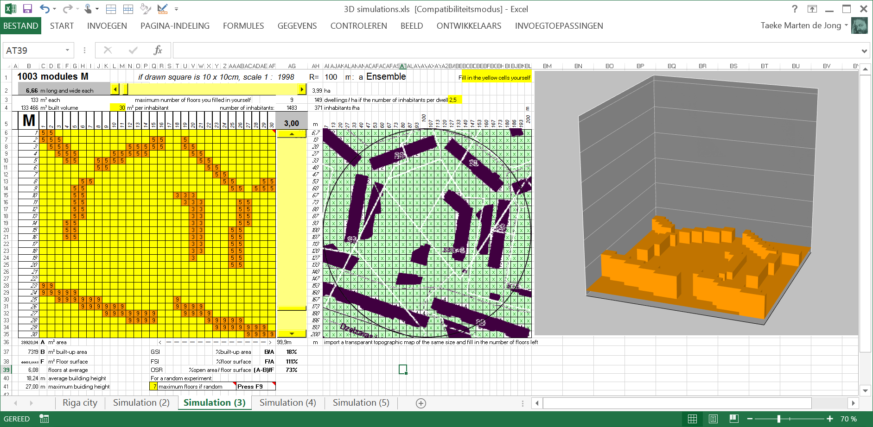
A 3D simulation…

Slide 31
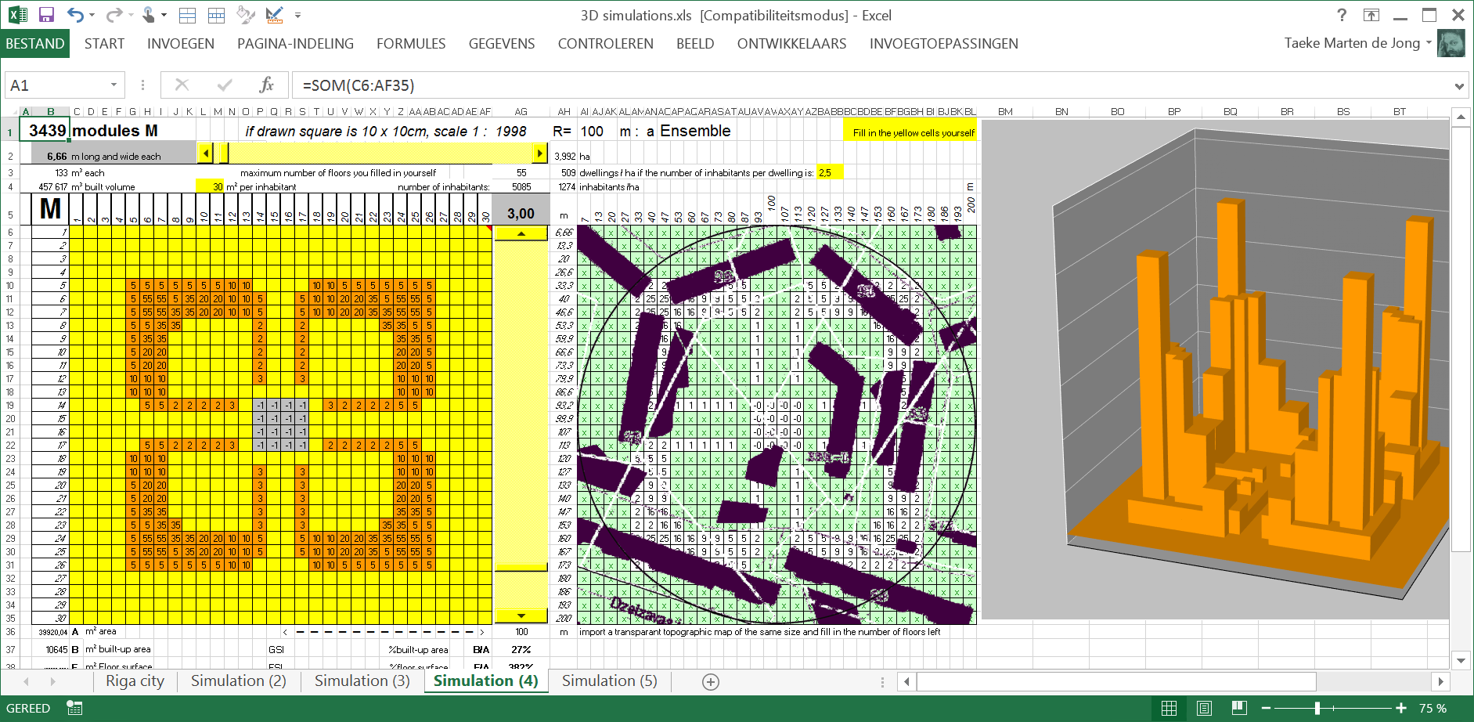
… may generate new ideas

Slide 32
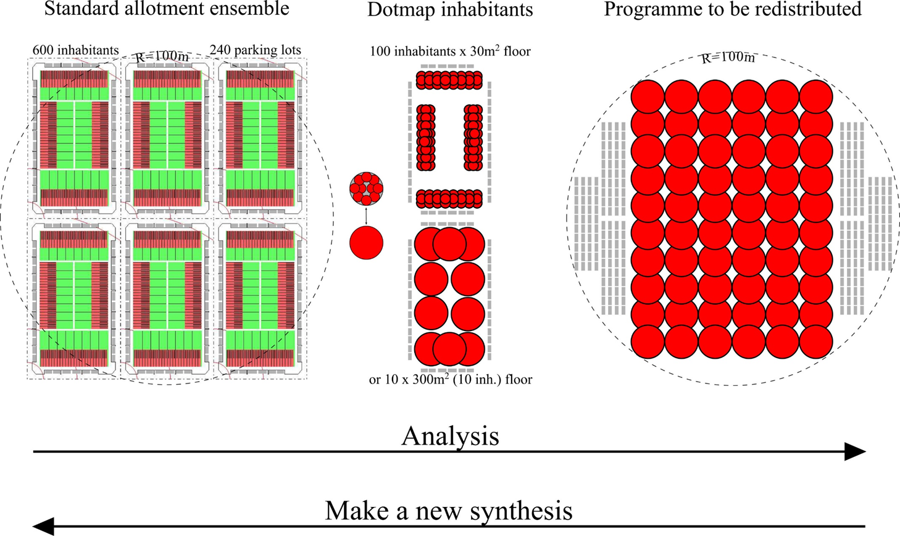
Exercise 1, R=100m ensemble form

Slide 33
Exercise 2: R=300m neighbourhood form
Prof.dr.ir. Taeke M. de Jong
Rīga Masterclass October 28th 2014

Slide 34
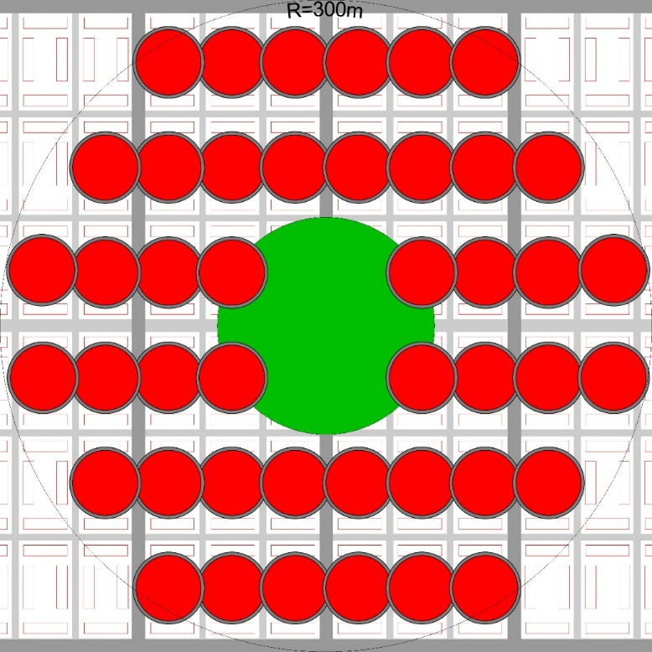
Exercise 2, R=300m neighbourhood form
Redistribute 44 dots of 100 inhabitants (r₁=30m_{floor}+3m_{parking}).
Replace one dot r₁ as neighbourhood centre.
Any dot r₁=30m can be split up into 10 dots of 10 inhabitants (r₂=10m).
Add a neighbourhood park r3=100m.
Widen 5 residential roads (5 x 600m long and 6m width) into neighbourhood roads (12m width).

Slide 35
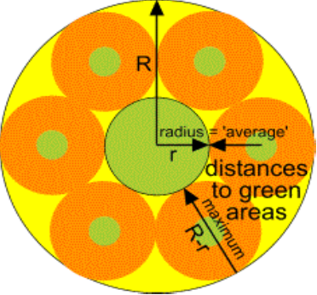
Standard Green Structure
Within any radius R an average distance r=R/3 into a substantial (1/10) green area.

Slide 36
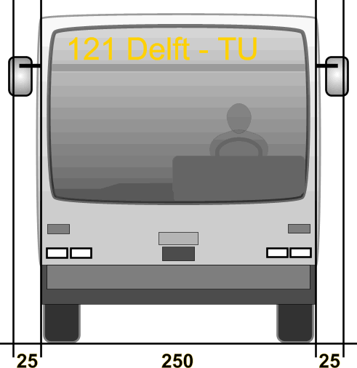
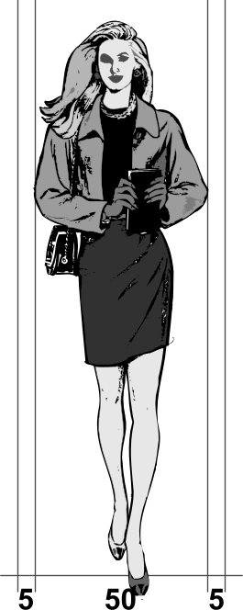
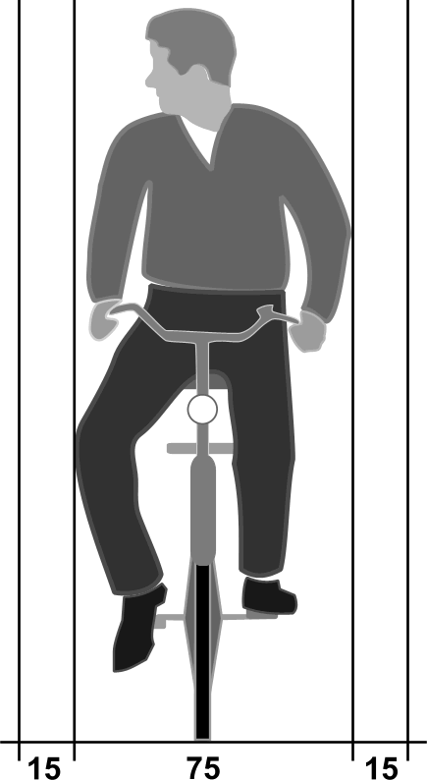
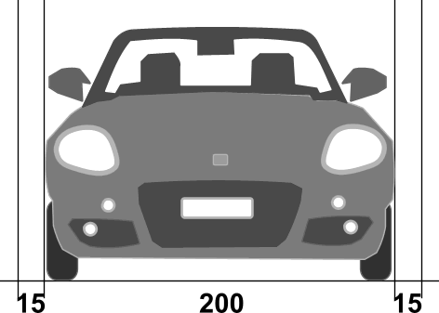
  Primary profile spaces needed
Pedestrian 50 + 2 x 5 ≅ 60 cm | Cyclist 75 + 2 x 15 ≅ 100 cm | Car 30 km/h 200 + 2 x 15 ≅ 230 cm | Bus 50 km/h 255 +2 x 25≅ 300 cm

Slide 37
  A neighbourhood

Slide 38
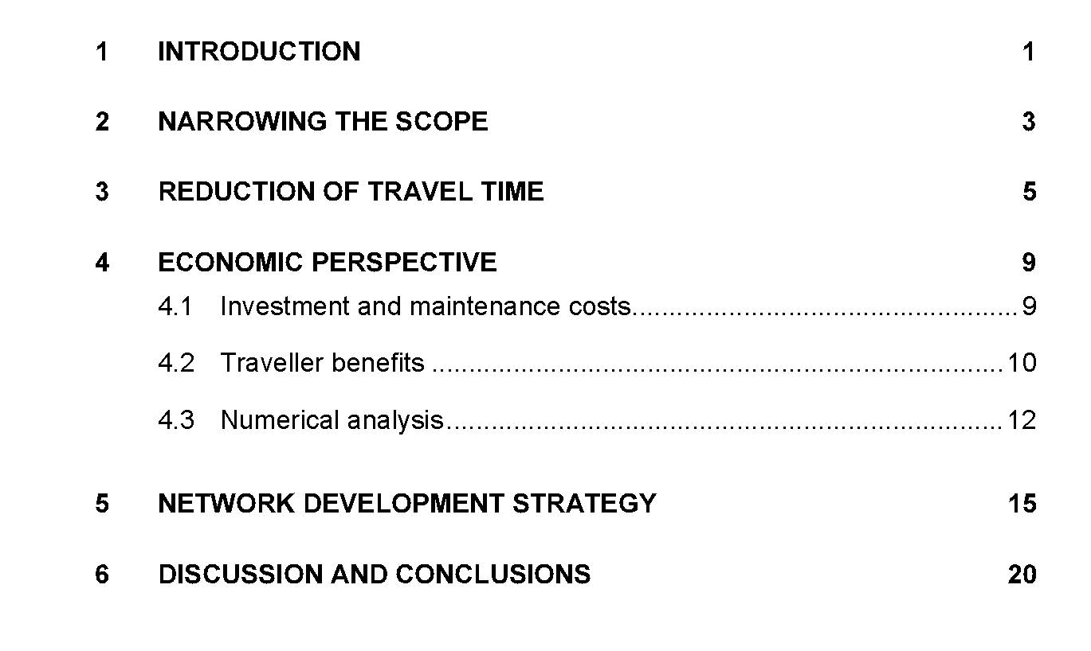
  Nes; Zijpp (2000) Scale Factor 3
  For Hierarchical Road Networks
  A Natural Phenomenon? (Delft)Trail

Slide 39
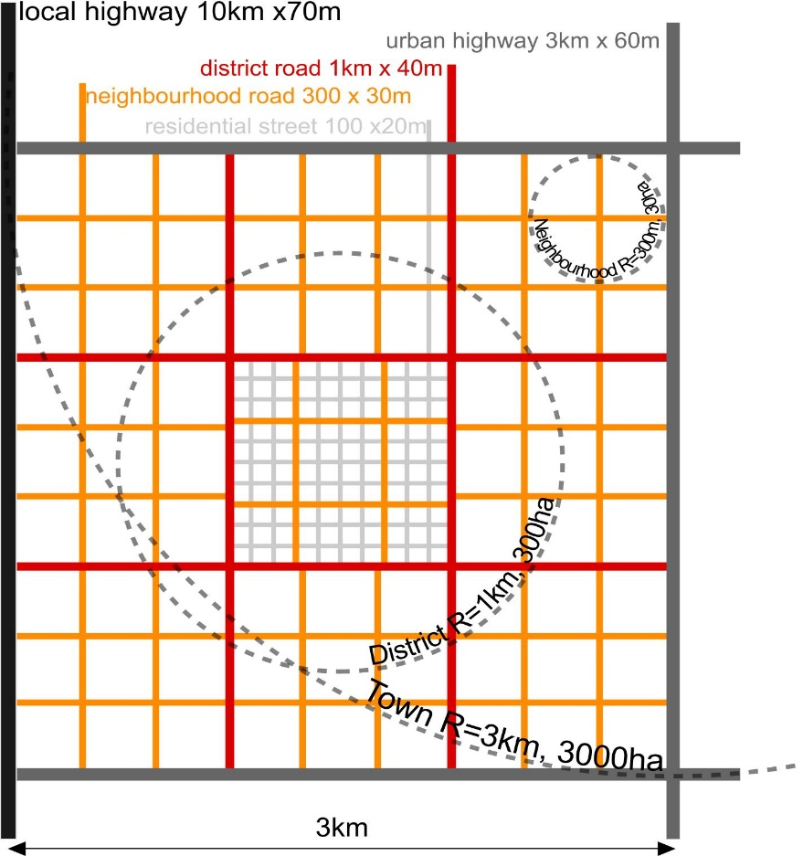
  A factor 3 network hierarchy
Category |  | 1 | 2 | 3 | 4 | 5 | 6 | 7 | 8
 |  | residential path | residential street | neighbourhood road | district road | urban highway | highway | regional highway | metropolitan highway
 | served area | estate | ensemble | neigh-bourhood | district | town | conur-bation | region | metropoli-tan region
m radius | mesh | crossing distance |  | 30 | 100 | 300 | 1 000 | 3 000 | 10 000 | 30 000 | 30 000
served inhabitants |  | 10 | 100 | 1 000 | 10 000 | 100 000 | 1 mln | 10 mln | 100 mln
number of floors |  | 1 | 2 | 3 | 4 | 6 | 7 | 8 | 10

Slide 40
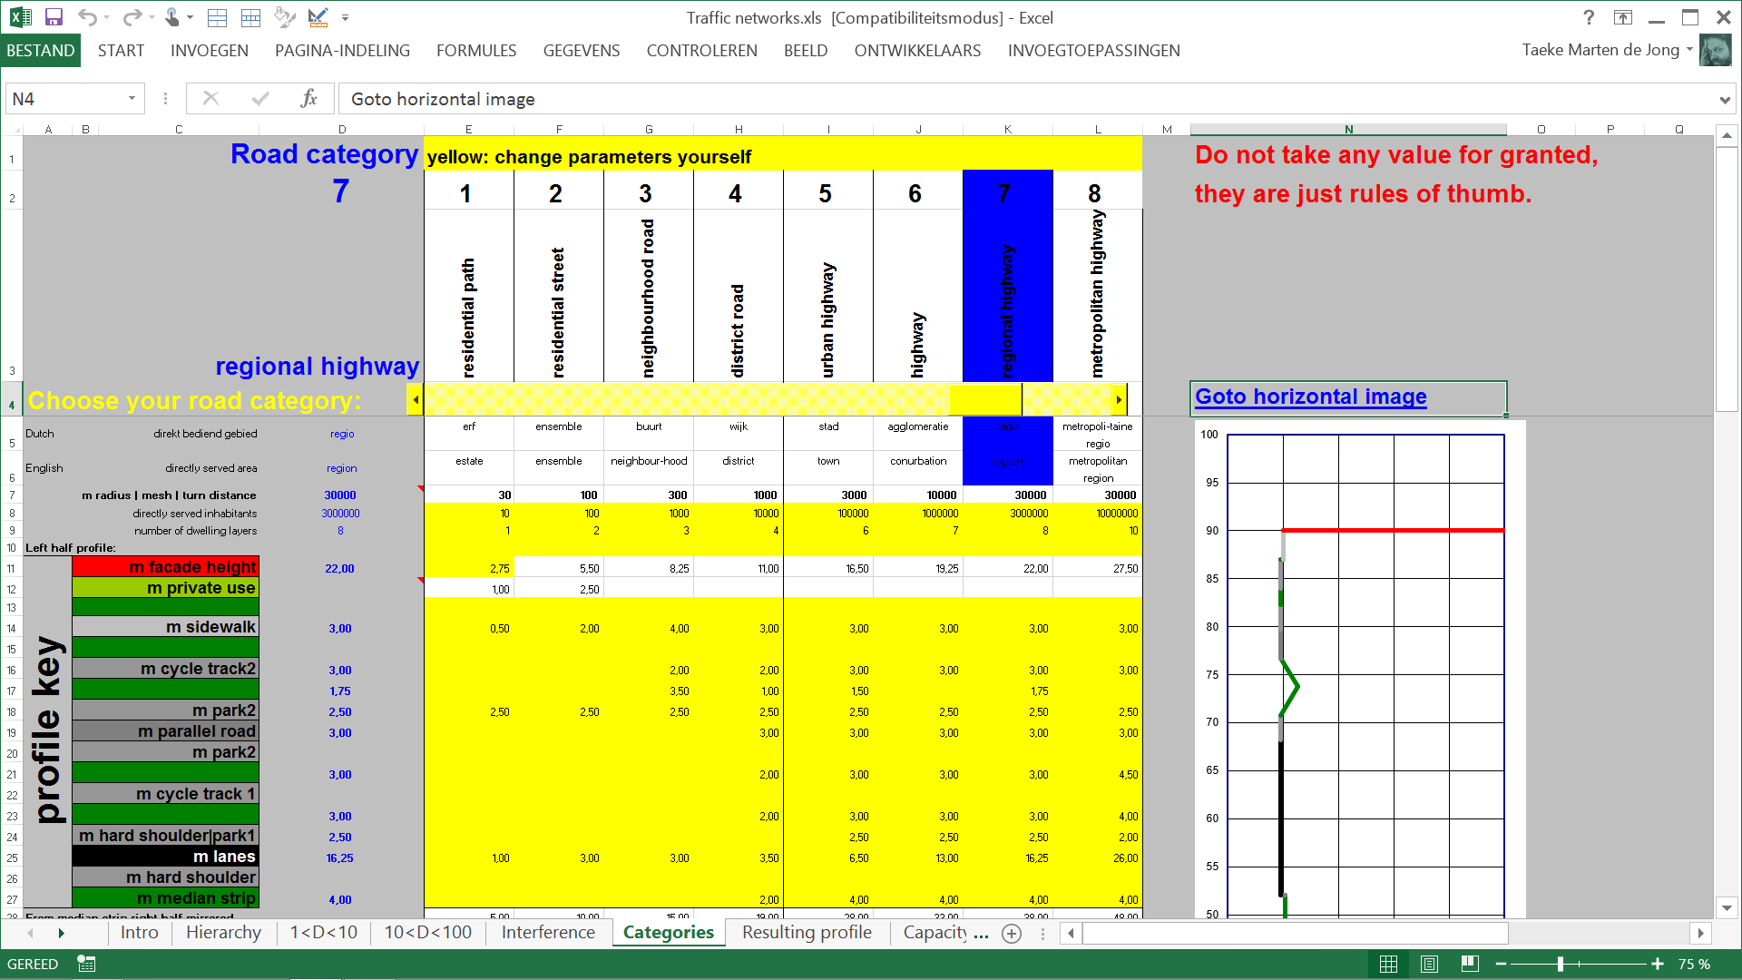
Excel profile generator

Slide 41
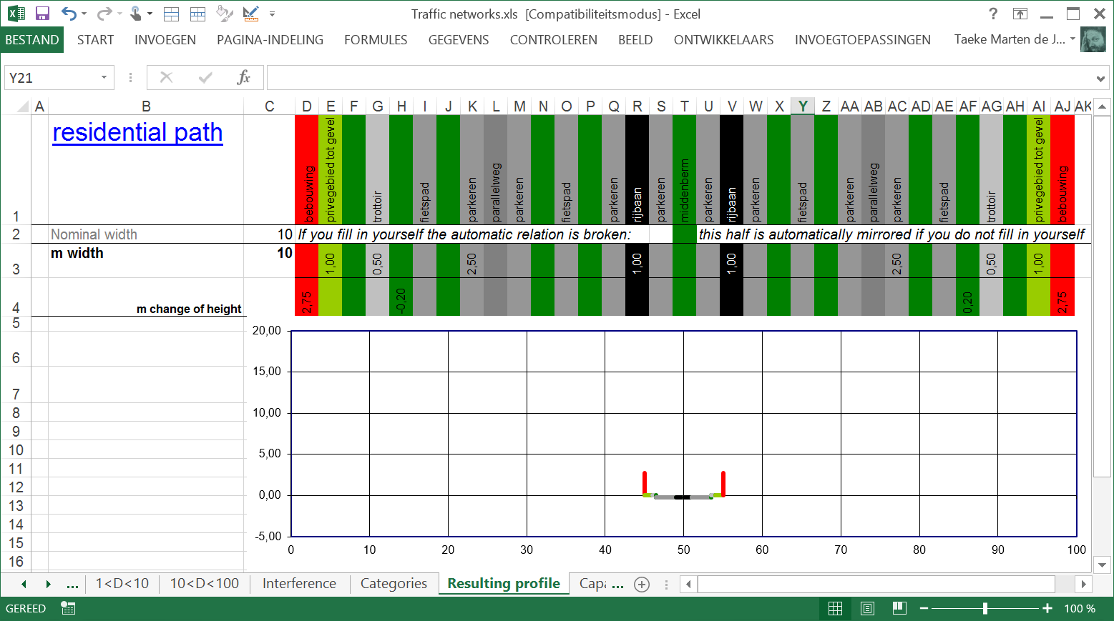
1 Standard residential path 10m

Slide 42

2 Standard residential street 20m

Slide 43

3 Standard neighbourhood road 30m

Slide 44
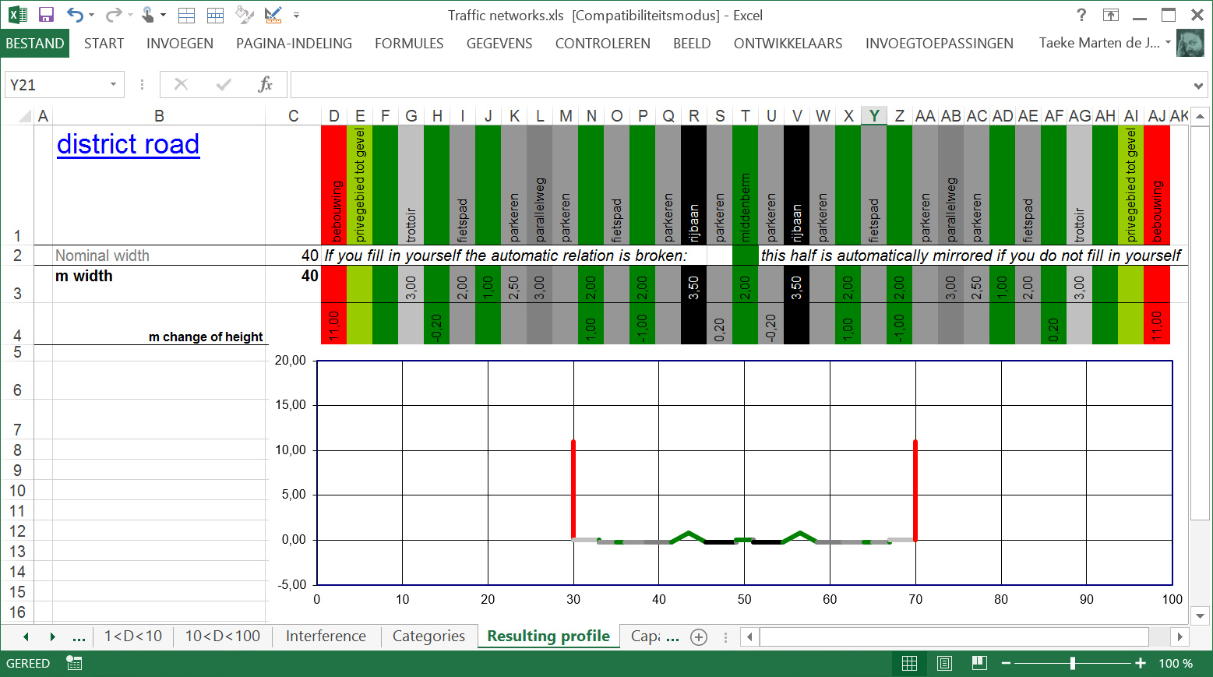
4 Standard district road 40m

Slide 45

5 Standard urban highway 60m

Slide 46
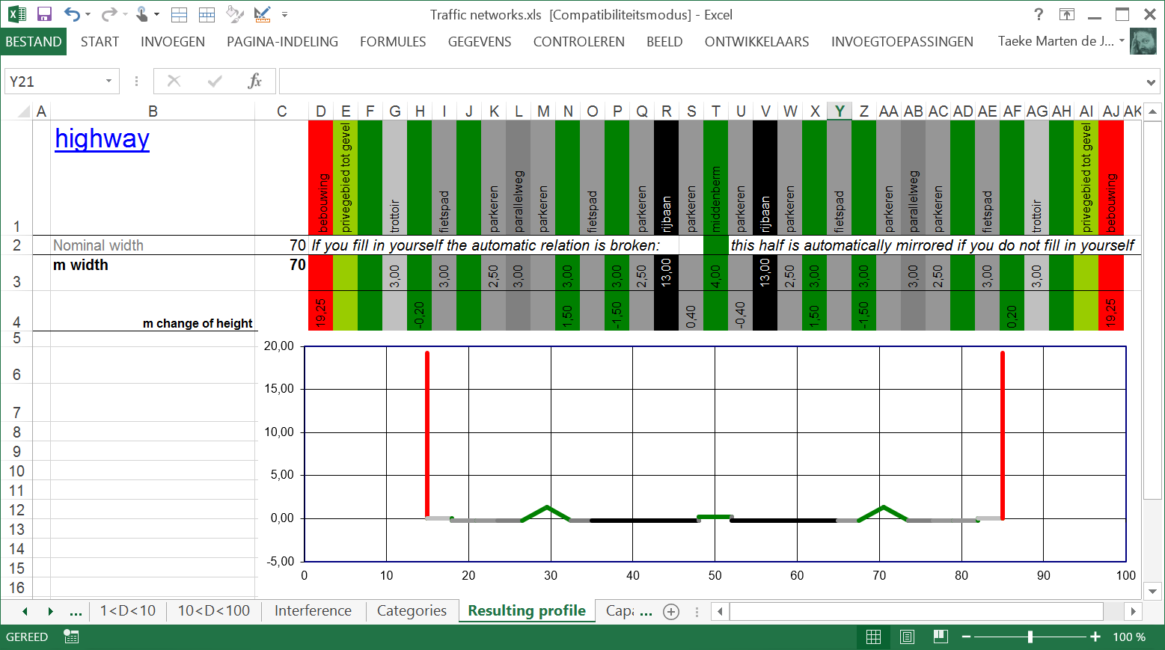
6 Standard highway 70m

Slide 47
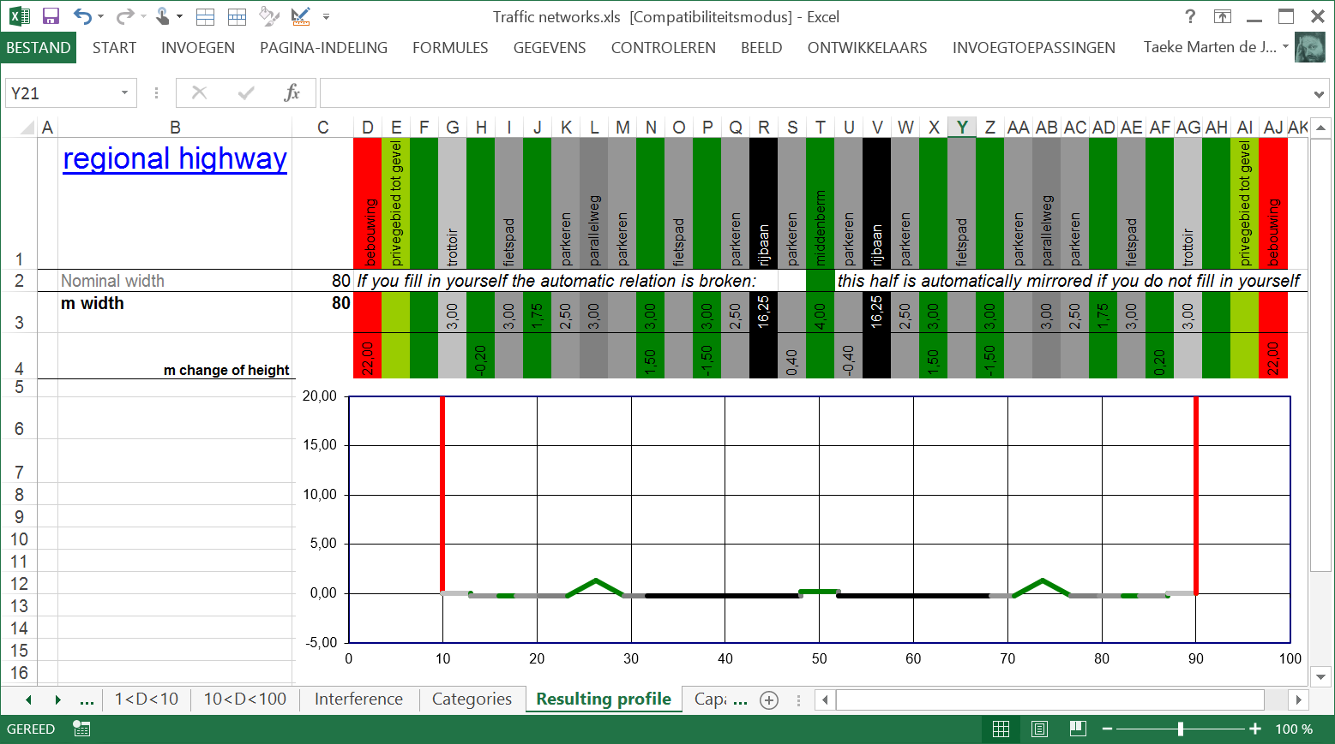
7 Standard regional highway 80m

Slide 48
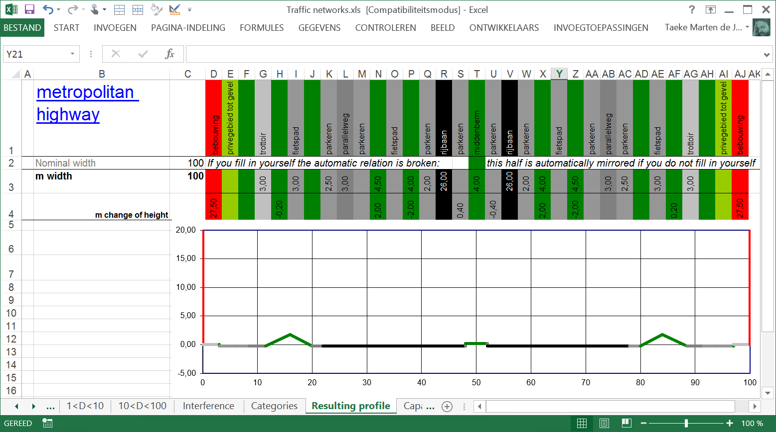
8 Standard metropolitan highway 100m

Slide 49
Physical measures, capacity and residential intensity
Category | 1 | 2 | 3 | 4 | 5 | 6 | 7 | 8
Physical infrastructure
m width between facades | 10 | 20 | 30 | 40 | 60 | 70 | 80 | 100
km/hour design velocity | 10 | 30 | 50 | 70 | 90 | 110 | 130 | 150
m minimum lane width | 1,75 | 2,25 | 2,75 | 3,25 | 3,25 | 3,25 | 3,25 | 3,25
number of lanes | 1 | 2 | 2 | 2 | 4 | 8 | 10 | 16
Capacity (possible use)
vehicles/h capacity per lane | 500 | 1 000 | 1 500 | 2 000 | 2 000 | 2 000 | 2 000 | 2 000
vehicles/hour capacity | 500 | 2 000 | 3 000 | 4 000 | 8 000 | 16 000 | 20 000 | 32 000
vehicles/24 hour capacity | 5 000 | 20 000 | 30 000 | 40 000 | 80 000 | 160 000 | 200 000 | 320 000
Use | Intensity
residential
directly served inhabitants | 10 | 100 | 1 000 | 10 000 | 100 000 | 1 mln | 3 mln | 10mln
car rides/inhabitant/day | 2,00 | 2,00 | 2,00 | 1,00 | 0,20 | 0,10 | 0,05 | 0,02
%surrounding infrastructure used | 50% | 50% | 50% | 50% | 50% | 50% | 50% | 50%
light vehicles/24 hour intensity | 20 | 200 | 2 000 | 10 000 | 20 000 | 100 000 | 150 000 | 200 000

Slide 50
Adding cargo and service, noise
Category | 1 | 2 | 3 | 4 | 5 | 6 | 7 | 8
cargo
kg cargo/inhabitant per day | 1,00 | 1,00 | 1,00 | 1,00 | 1,00 | 1,00 | 1,00 | 1,00
kg cargo/vehicle | 10 | 100 | 1 000 | 1 000 | 1 000 | 1 000 | 1 000 | 1 000
cargo vehicles/24 hour intensity | 2 | 2 | 2 | 20 | 200 | 2 000 | 6 000 | 20 000
service
service visit/inhabitant/day | 0,01 | 0,01 | 0,01 | 0,02 | 0,01 | 0,00 | 0,00 | 0,00
service vehicles/24 hour intensity | 0,20 | 2,00 | 20 | 400 | 2 000 | 2 000 | 6 000 | 2 000
Total including residential use
vehicles/24 hour intensity | 22 | 204 | 2 022 | 10 420 | 22 200 | 104 000 | 162 000 | 240 000
vehicles/hour intensity | 2 | 20 | 202 | 1 042 | 2 220 | 10 400 | 16 200 | 24 000
vehicles/hour peak intensity
% use by car = intensity/capacity | 0,4% | 1,0% | 7% | 26% | 28% | 65% | 81% | 75%
noise
dB(A) noise on façade | 66 | 59 | 62 | 74 | 80 | 84 | 90 | 96
% devaluation houseprice by noise | 10% | 5% | 7% | 22% | 34% | 40% | 48% | 54%

Slide 51
Exercise 2, R=300m neighbourhood form
Redistribute 44 dots of 100 inhabitants (r₁=30m_{floor}+3m_{parking}).
Replace one dot r₁ as neighbourhood centre.
Any dot r₁=30m can be split up into 10 dots of 10 inhabitants (r₂=10m).
Add a neighbourhood park r3=100m.
Widen 5 residential roads (5 x 600m long and 6m width) into neighbourhood roads (12m width).

Slide 52
Exercise 3: R=1km district
Prof.dr.ir. Taeke M. de Jong
Rīga Masterclass October 28th 2014

Slide 53
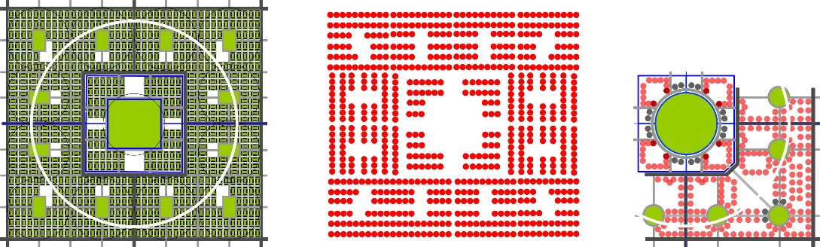
Exercise 3, R=1km district
Redraw a next component of R=1km (70 000inh.), r₁=30m (100inh.), r₂=100m green, r₃=300m green

Slide 54

Look for components and details

Slide 55
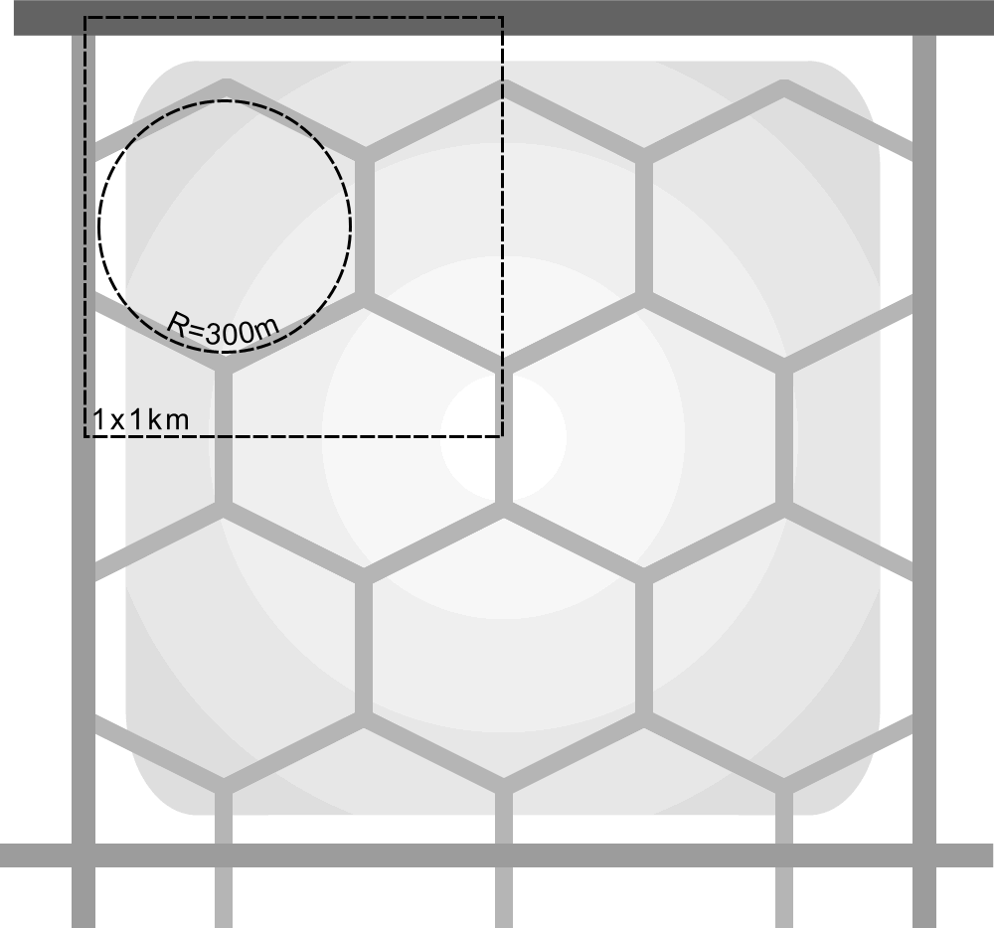
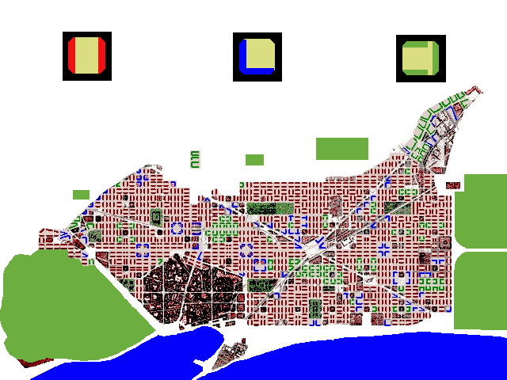




Cerda and Buchanan
Hexagonal neighbourhoods: less pavement and traffic calming
Cut-off corners make a square of every crossing
Square neighbour-hoods
Plan Cerdà (1867) in Barcelona
A Cerdà neighbourhood
Residential streets 20m
Neighbourhood roads 30m
District roads 50m wide
The Buchanan grid put in a square 2x2km

Slide 56


The formation of rectangles
A higher order straightens a hexagonal pattern
Elongating diminishes the number of crossings
Length (L) and width (W) of the mesh for the same net density of
2 km/km²

Slide 57









The advantage of rectangularity (Bach)
Making a short cut as long as the detour
Easily providing a centre
Easily diminishing access crossings
Easily introducing one way traffic
Easily giving way to other networks such as cycle paths
However, he content of a crooked grid is less than a rectangular one, while its outline is the same as the square.
So, it will cost more pavement per inhabitant.
Easily accepting ongoing green lines
Exceptions draw special attention
Easy hinging to other grids
Crooked grids keep easy orientation

Slide 58



Safe residential paths save pavement

Slide 59


Less roads Central space looks larger
Leaving out some neigbourhood roads
Same built-up area optically full or empty

Slide 60




T-crossings safer than X-crossings (Camillo Sitte)
A roundabout: 4 T-crossings

Slide 61




Zoetermeer’s T-crossing strategy
First sketch
Realized
A nice idea, but the drivers appear to take equal risk:
they drive faster.

Slide 62

Tunnels: slopes divide adjacent neighbourhoods

Slide 63
Count your crossings (costs)
 | residential streets (20m wide) | neighbourhood roads (30m wide) | district roads (40m wide)
residential streets | 32
neighbourhood roads | 20 | 4
district roads | 4 | 2 | 1
main ditches (3m wide) | 16 | 8 | 4
water courses (10m wide) |  | 5 | 2

Slide 64

Dry networks

Slide 65

Wet networks

Slide 66

Interference of dry and wet networks
Elongating saves crossings

Slide 67




Superposition and interference
Rivers, canals and brooks
Superposition of races
Interference with highways
Interference with highways and railways

Slide 68


Pedestrians
Reichow: car first
Runcorn: pedestrian first

Slide 69

Public transport(Bach)
Collecting travellers
Connecting travellers

Slide 70


Types of bus stops
Island type of central bus station
Herringbone type of central bus station

Slide 71

Two types of shopping centres with a bus stop

Slide 72
Exercise 3, R=1km district
Redraw the next component of R=1km (70 000inh.), r₁=30m (100inh.), r₂=100m green, r₃=300m green

Slide 73
Exercise 4: R=3km town, city
Prof.dr.ir. Taeke M. de Jong
Rīga Masterclass October 28th 2014

Slide 74


Exercise 4, R=3km town, city
Characterise the components of the city with a name explaining their identity.
Draw dots of standardised size (r={100m, 300m}) for non-residential functions.

Slide 75

Variables, legend units, character

Slide 76
Social and urban specialisation to be recognisable in towns
 | Specialisation | Urban facilities
Administration | legislative power | town hall, parliament
 | legal/administrative | law court/government services
 | executive power | police station, prisons, military facilities
Culture | religion/ ideology | churches, monuments, signs
 | art/science | museums, institutes, libraries
 | up-bringing/education | schools
Economy | production | companies, offices
 | exchange | infrastructure, shops, banks
 | consumption | hospitals, leisure facilities, parks, dwellings

Slide 77

Production

Slide 78

GuiYang Masterplan of Kingsbury International Holdings 2007

Slide 79


An alternative for sprawl
Analysis of the masterplan
Concentration

Slide 80


Give the mountain a crown

Slide 81


Strengthen the landscape

Slide 82
Exercise 4, R=3km town, city
Characterise the components of the city with a name explaining their identity.
Draw dots of standardised size (r={100m, 300m}) for non-residential functions.

Slide 83
Exercise 5: R=10km conurbation
Prof.dr.ir. Taeke M. de Jong
Rīga Masterclass October 28th 2014

Slide 84


A dotmap adds form and surface to a list of data

Slide 85


Easy visualizing proposals for change

Slide 86


Exercise 5, R=10km conurbation
Make a dotmap R=10km, r=100m (1000 inhabitants) of Rīga using municipal data of inhabitants per district, and a map showing the built-up areas in order to approach the form.

Slide 87
Exercise 6: R=30km urban region
Prof.dr.ir. Taeke M. de Jong
Rīga Masterclass October 28th 2014

Slide 88

Exercise 6, R=30km urban region
Characterise the components of the region with a name explaining their identity.
Name variables expressing changes of character over 30km
Name some of their values as useful legend units

Slide 89

Exercise 6, R=30km urban region
Characterise the components of the region with a name explaining their identity.
Name variables expressing changes of character over 30km
Name some of their values as useful legend units

Slide 90




Easy making scenarios (Adapazarı)
Actual
400 000 inh.
High risk
2 000 000 inh.
Low risk
2 000 000 inh.
1 000 inhabitants or employees
gross dots r₁=300m (30ha)
net dots r₂=100m (3ha)

Slide 91



Phases of sprawl R=30km, this time …

Slide 92



… may create identity R=1km, r={300, 100m}

Slide 93

Exercise 6, R=30km urban region
Characterise the components of the region with a name explaining their identity.
Name variables expressing changes of character over 30km
Name some of their values as useful legend units

Slide 94
Exercise 7: R=10km Rīga conurbation
Prof.dr.ir. Taeke M. de Jong
Rīga Masterclass October 29th 2014

Slide 95

  Exercise 7, R=10km Rīga conurbation
Compare the mesh-width of roads with the hierarchy of page 29.
Indicate areas with the number of their lowest category (1-8).
Indicate missing categories.
Compare the distribution of green with the SGS of page 20.
Write a proposal for a design study about the Rīga conurbation.

Slide 96
A not yet existent object has a scale, an existent context and desired impacts

Slide 97



A subregional object in its regional economic context
Our project has a radius of 10km.
We do not take less than 100m into account.
The context is 30km regional economy.
We hope that the project will have a positive impact (P) in its economic context.
But, this desired impact depends on tacit expectations about the future.

Slide 98



Next screen of the program: our expectations in the relevant fields
We expect 10km concentration (C), …
… but 100m deconcentration (D), …
… and regional economic growth (+)
If these expectations until 2030 are legitimate,
then we may hope that our project will contribute to the regional economy.

Slide 99
  A study proposal generated by the program
If you push the button left below, than an adaptable .txt concept proposal is made in the map where the program itself is located on your computer.

Slide 100
  Your concept proposal from the computer
CONTENTS
<as soon as you have added a heading style to each heading in Word, you can automatically insert a list of contents here>
1 OBJECT OF STUDY AND ITS CONTEXT
1.1 OBJECT OF MY STUDY
The object of study has the resolution of a drawing for 2030 on conurbation (R=10km) scale with smallest details on Ensemble(r=100m) level.
1.2 PROBABLE FUTURE CONTEXT: FIELD OF PROBLEMS
My assumptions about the probable future context of the object of study until 2030 are:

Slide 101
  Your probable future context
Future 2030 | Global(10000km) | Continental(3000km) | Subcontinental(1000km) | National(300km) | Subnational(100km) | Regional(30km) | Conurbation(10km) | Town(3km) | District(1km) | Neighbourhood(300m) | Ensemble(100m) | Buildingcomplex(30m) | Building(10m) | Buildingsegment(3m) | Buildingpart(1m) | Buildingcomponent(300mm) | Superelement(100mm) | Element(30mm) | Subelement(10mm) | Supermaterial(3mm) | Material(1mm) | Submaterial(<1mm)
management
culture
economy |  |  |  |  |  | +
technique
ecology
physics |  |  |  |  |  |  | C |  |  |  | D

Slide 102
  A probable but not desirable future delivers your problem statement
As far as this future is not desirable it will generate a field of problems.
As relevant probable but undesired development (emerging problems) I consider: a less attractive region if population increases without a plan accommodating economic growth.
1.3 DESIRED IMPACTS OF MY STUDY: FIELD OF AIMS
My study derives its motivation, intention, aims or even programme of requirements from fields indicated by a P in the next table:

Slide 103
  Desired impacts of your study
Impacts 2030 | Global(10000km) | Continental(3000km) | Subcontinental(1000km) | National(300km) | Subnational(100km) | Regional(30km) | Conurbation(10km) | Town(3km) | District(1km) | Neighbourhood(300m) | Ensemble(100m) | Buildingcomplex(30m) | Building(10m) | Buildingsegment(3m) | Buildingpart(1m) | Buildingcomponent(300mm) | Superelement(100mm) | Element(30mm) | Subelement(10mm) | Supermaterial(3mm) | Material(1mm) | Submaterial(<1mm)
management
culture
economy |  |  |  |  |  | P
technique
ecology
physics |  |  |  |  |  |  | O |  |  |  | o

Slide 104
  Who may support your study?
It also indicates which actors (problem owners) will be primarily favoured by realising the results of my study:
An actor on the layer and level of growing (+) Regional(30km) economy is the economic department of the region.
It possibly will support an assignment and a programme of requirements to change undesired developments.

Slide 105
  Your design means and abilities, your proposal
1.4 MY DESIGNERLY REFERENCES: FIELD OF MEANS
Examples within a similar context below fascinate me professionally: …
1.5 MY PORTFOLIO AND PERSPECTIVE: FIELD OF ABILITIES
From my previous work, next elements are useful for this project.
2 MY STUDY PROPOSAL
2.1 LOCATION AND OTHER FUTURE CONTEXT FACTORS
The object of study has the resolution of a drawing for 2030 on Conurbation(R=10km) scale with smallest details on Ensemble(r=100m) level. The actual object will be located in Latvia.

Slide 106
  Your programme of requirements, expected results and time table
2.2 MOTIVATION OR PROGRAMME OF REQUIREMENTS
With regard to my assumptions about the future context (1.2) and referring to the intended impacts (1.3) as a result of this study
Regional(30km) economy usually growing (+) should be supported through the design of efficient economic concentrations.
2.3 INTENDED RESULTS, CONTRIBUTIONS AND PLANNING
I expect next products of my study: …
It has enough limitations to be realised in next time table: …
<add here a time table>

Slide 107
  Criteria for quality and references
3 ACCOUNTS
3.1 MEETING CRITERIA FOR A STUDY PROPOSAL
This study proposal demonstrates:
A Affinity with designing.
B University latitude.
C Concept formation and transferability.
D Retrievability and Accumulating capacity.
E Methodical accountability and depth.
F Ability to be criticised and to criticise.
G Convergence and limitation.
3.2 REFERENCES

Slide 108

  Let us ask the stakeholders, specialists and future users

Slide 109
  Exercise 7, R=10km Rīga conurbation
Compare the mesh-width of roads with the hierarchy of page 29.
Indicate areas with the number of their lowest category (1-8).
Indicate missing categories.
Compare the distribution of green with the SGS of page 20.
Write a proposal for a design study about the Rīga conurbation.

Slide 110
Exercise 8: R=3km Rīga city
Prof.dr.ir. Taeke M. de Jong
Rīga Masterclass October 29th 2014

Slide 111

  Exercise 8, R=3km Rīga city
Re-arrange non-residential functions according to your characterisation (see page 62 and 66).
Indicate industrial areas with specialised facilities for specialised enterprises.
Indicate shopping centres on city~ and district level.

Slide 112

  Shopping malls

Slide 113
Exercise 9: R=1km Rīga district
Prof.dr.ir. Taeke M. de Jong
Rīga Masterclass October 29th 2014

Slide 114

  Exercise 9, R=1km Rīga district
Draw a composition of neighbourhood components (see page 9).
Look for design means in order to make them recognisably different.
Look for proper locations of shopping and enterprises.
Diversify plantation per neighbourhood

Slide 115

Plantation

Slide 116
Exercise 10: R=0,3km Rīga neigbourhoods
Prof.dr.ir. Taeke M. de Jong
Rīga Masterclass October 29th 2014

Slide 117

Exercise 10, R=0,3km Rīga neigbourhoods
Re-arrange these neighbourhoods adding 1000 inhabitants to the
13 000 drawn.

Slide 118

Highrise and sun

Slide 119

Exercise 11: R=0,1km Rīga ensemble
Prof.dr.ir. Taeke M. de Jong
Rīga Masterclass October 29th 2014

Slide 120

Exercise 11, R=0,1km Rīga ensemble
Concentrate this ensemble into less, but higher buildings.

Slide 121

Simulations may challenge

Slide 122

From building into neighbourhood

Slide 123


⇑Re_{10m}
Re_{30m}
Re_{10m}
Re_{3m}
Re_{1m}
⇑Va_{10m}
Va_{30m}
Va_{10m}
Va_{3m}
Va_{1m}
⇑Va_{10m}
Va_{30m}
Re_{10m}
Va_{3m}
Re_{1m}

Slide 124


⇑Va_{10m}
Va_{30m}
Re_{10m}
Va_{3m}
Re_{1m}
⇑Re_{10m}
Va_{30m}
Re_{10m}
Re_{3m}
Re_{1m}
⇑Va_{10m}
Va_{30m}
Re_{10m}
Va_{3m}
Va_{1m}
⇑Va_{10m}
Va_{30m}
Va_{10m}
Va_{3m}
Va_{1m}

