Slide 1

Urban design quality, a function of variety
Prof.dr.ir. Taeke M. de Jong
R. Schmaeling conference
Rīga October 29th 2014

Slide 2
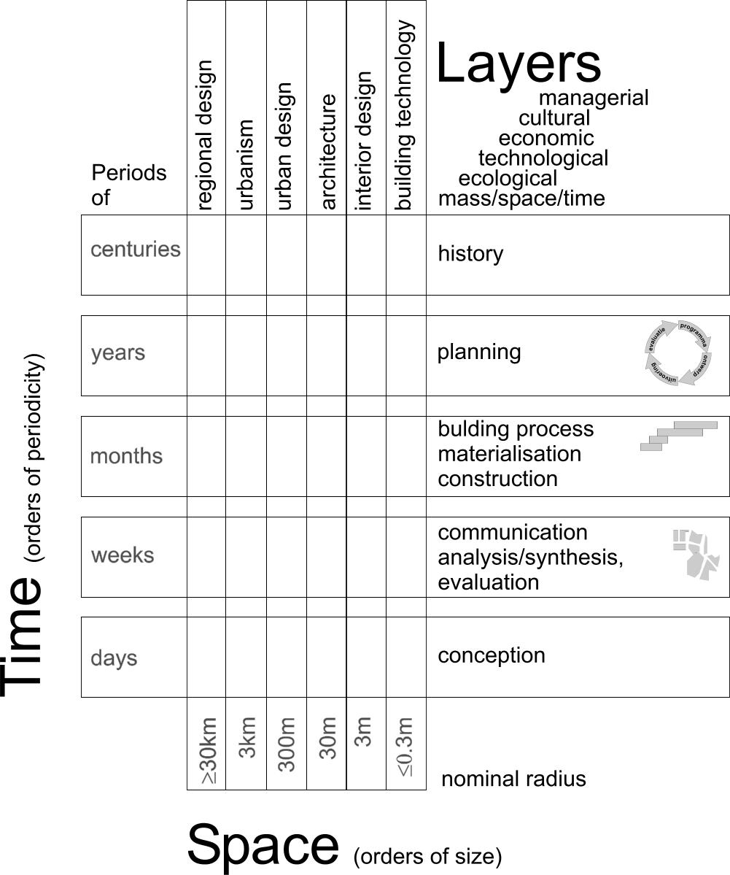
The domain of Urban and Architectural design
Imagine a school with elevators and corridors leading you through different spatial levels, time-spans, and layers of design.

Slide 3
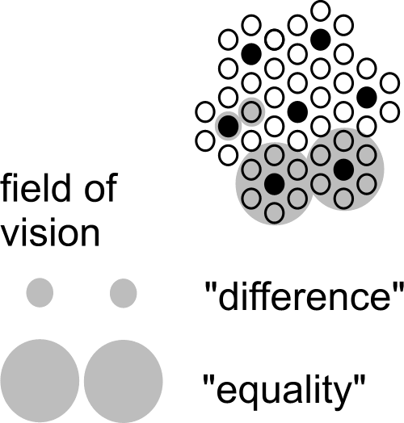
A scale paradox, its factor 3
Any conclusion about space is scale-sensitive.
It can change into its opposite already with a factor 3 of scale.

Slide 4
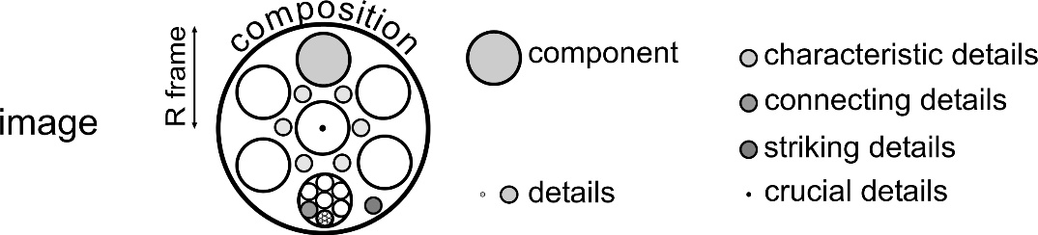
Ten levels of variety to be explored
Look for differences at any level of scale

Slide 5
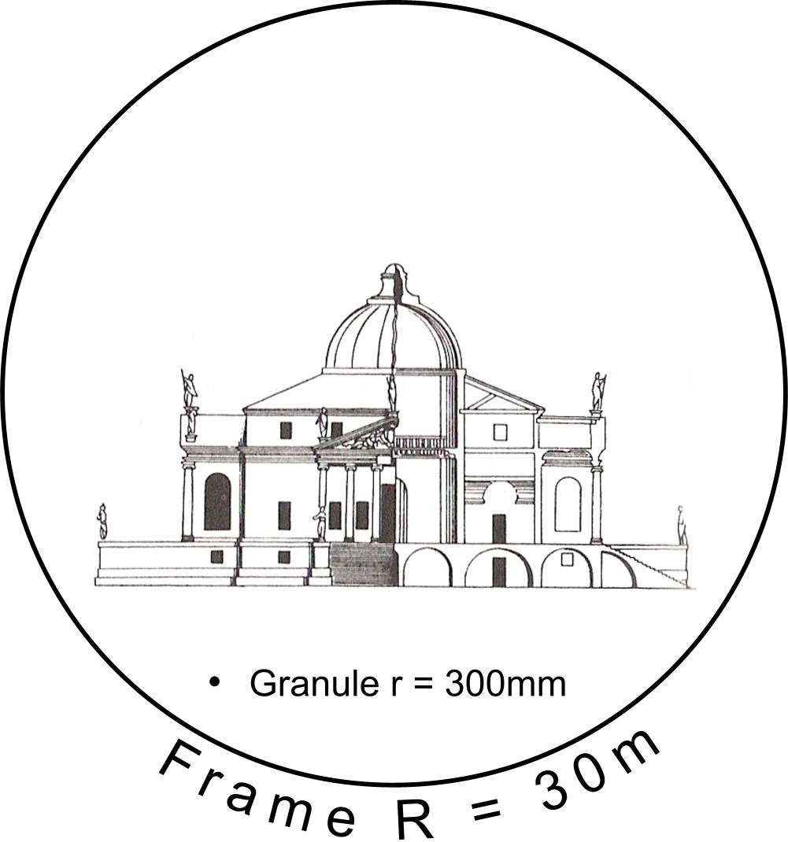
A frame 100x the grain of a drawing representing a building
Any representation has an upper and a lower boundary:
a frame and a grain.
Let us notate them as a ‘nominal radius’ R and r.

Slide 6
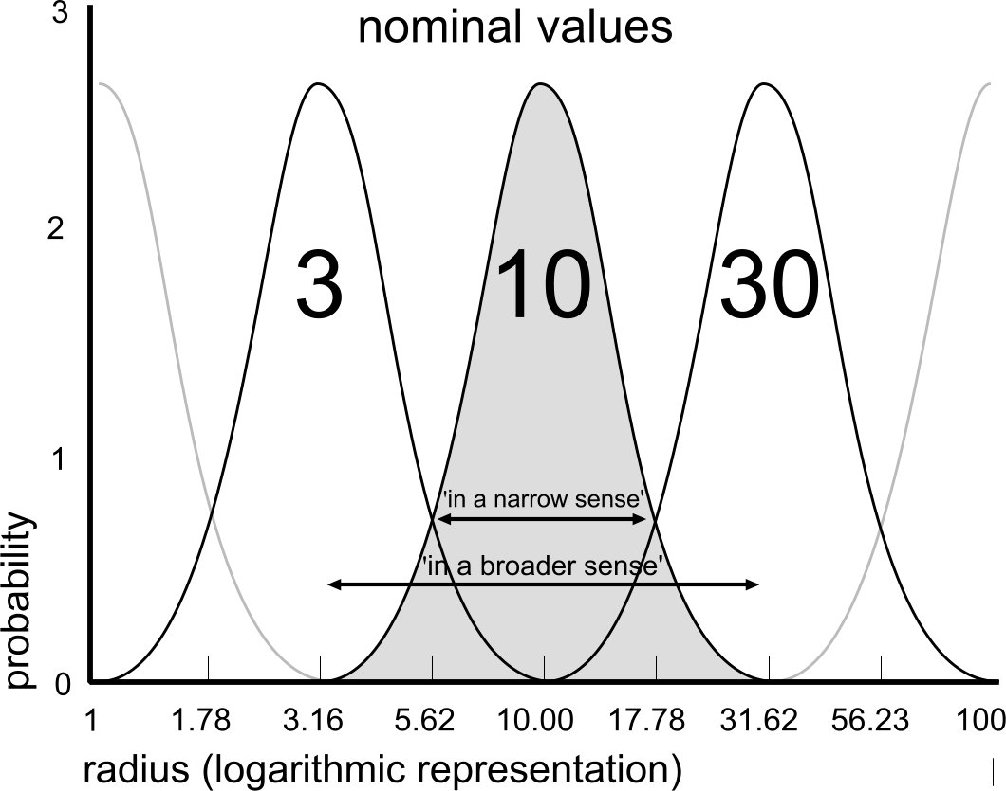
Boundaries of nominal R and r
A ‘nominal’ radius is a name for a range of measures.
‘R=10m’ is something between 3m and 30m.

Slide 7
Usual names fitting R=

Slide 8
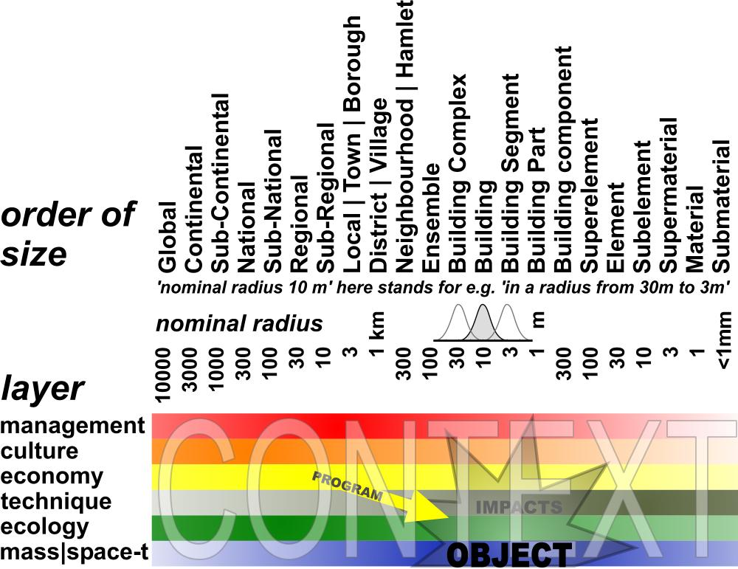
Object in Context (months, years)
Any object has impacts in different layers of context at different levels of scale.
A programme is simply a set of intended impacts.

Slide 9
Ten levels of variety to be explored
Look for differences at any level of scale

Slide 10
Content diversifies space
Some values of named variables may serve as legend units.

Slide 11
  Form distributes content in space

Slide 12
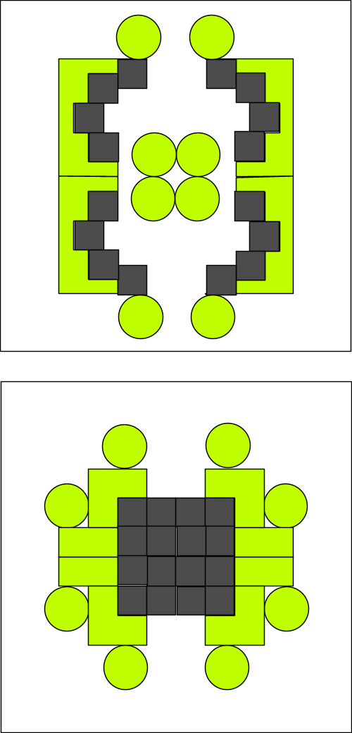
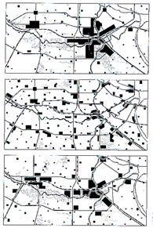
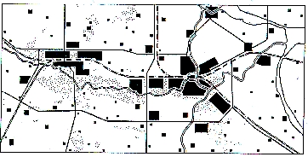
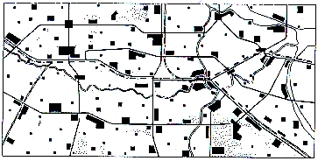
Form = state of distribution
Accumulation
Deconcentration
Concentration
Sprawl

Slide 13
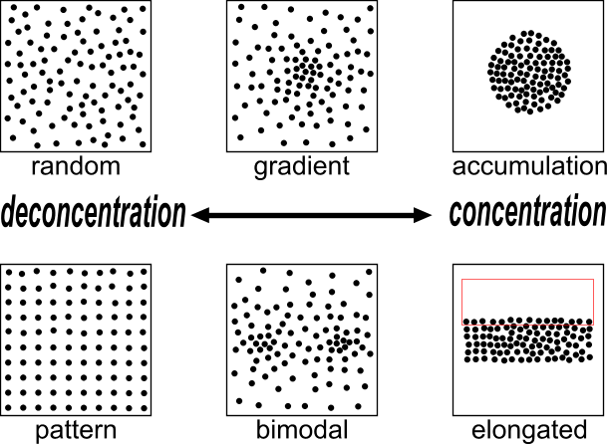
States of distribution of 100 spots
Any shape appears between total sprawl and total accumu-lation

Slide 14
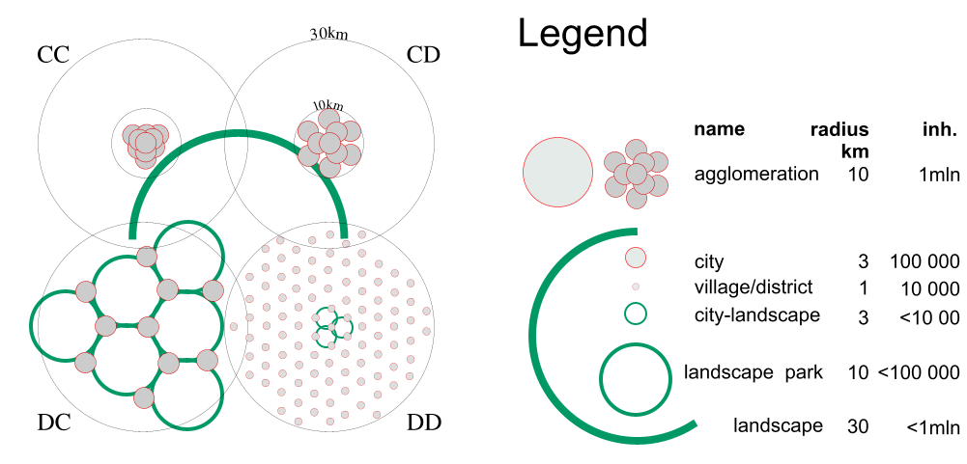
Concentration and Deconcentration at 2 levels ...
… result in accumulation and sprawl
at different levels of scale.

Slide 15
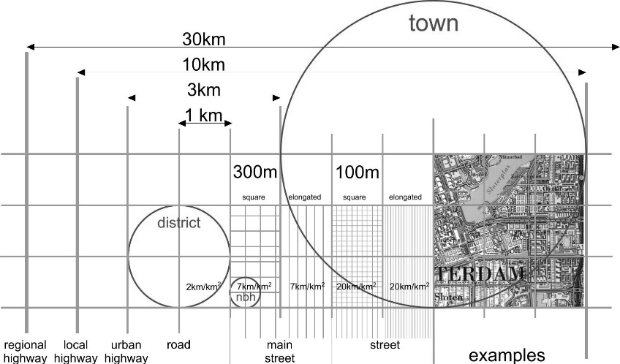
Structure stabilises form

Slide 16
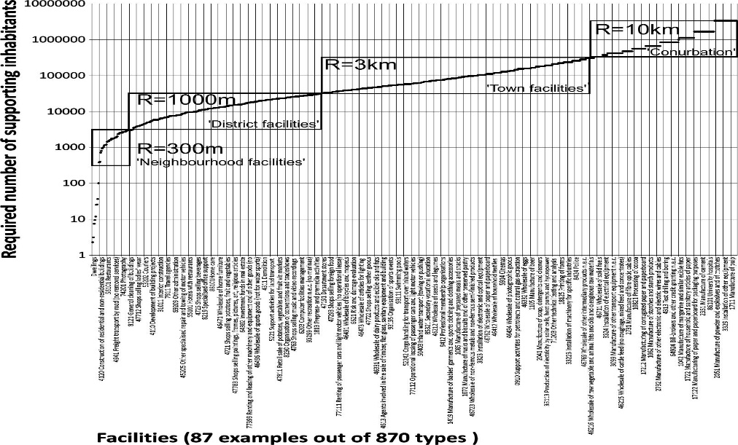
Functions at different levels of scale

Slide 17
Intentions and expectations about the object in its context
Stakeholders, specialists and users can be located on scale and layer.
Ask them to specify the intentions and expectations in their position.

Slide 18
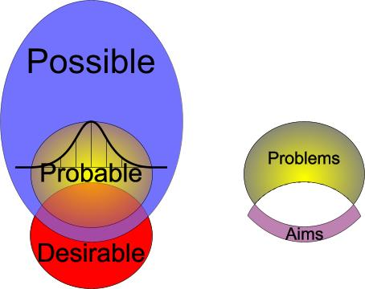
Intentions and expectations are different modes of thinking

Slide 19
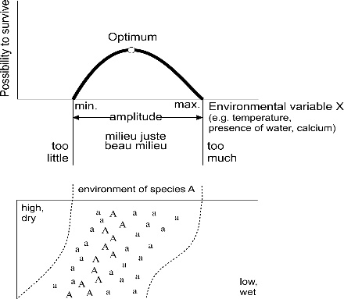
What is spatial quality?

Slide 20
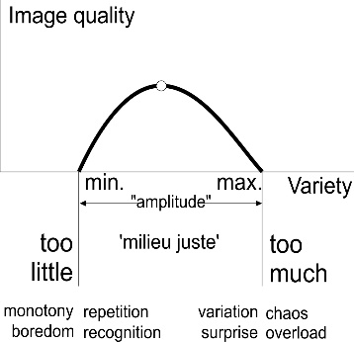
Quality as a function of variety

Slide 21
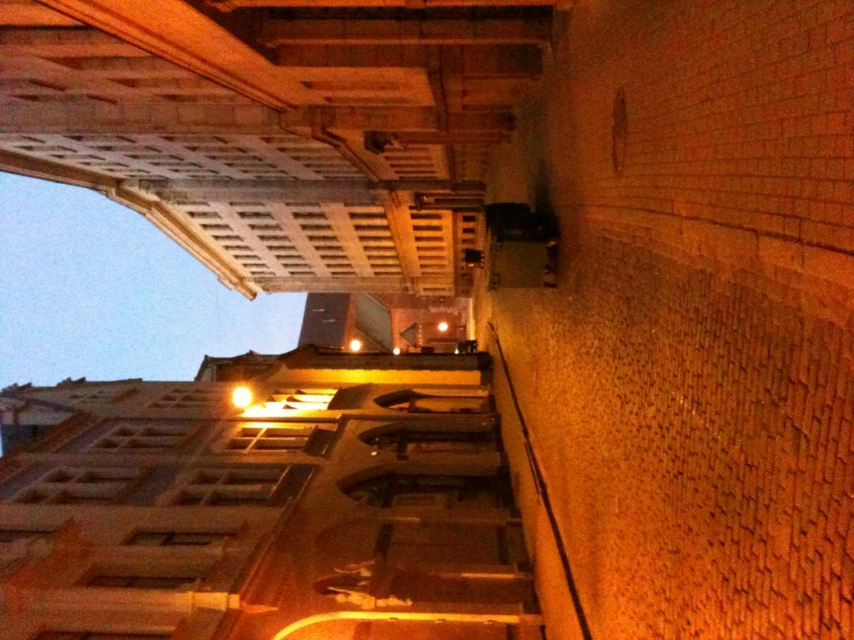
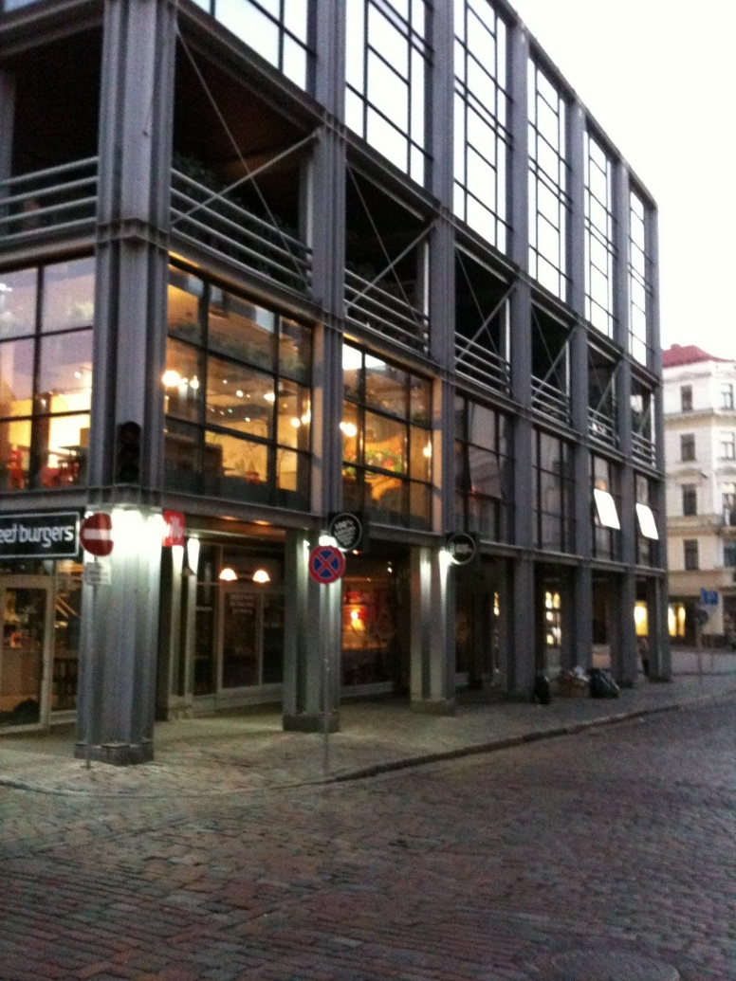
⇑Re_{10m}
Re_{30m}
Re_{10m}
Re_{3m}
Re_{1m}
⇑Va_{10m}
Va_{30m}
Va_{10m}
Va_{3m}
Va_{1m}
⇑Va_{10m}
Va_{30m}
Re_{10m}
Va_{3m}
Re_{1m}

Slide 22
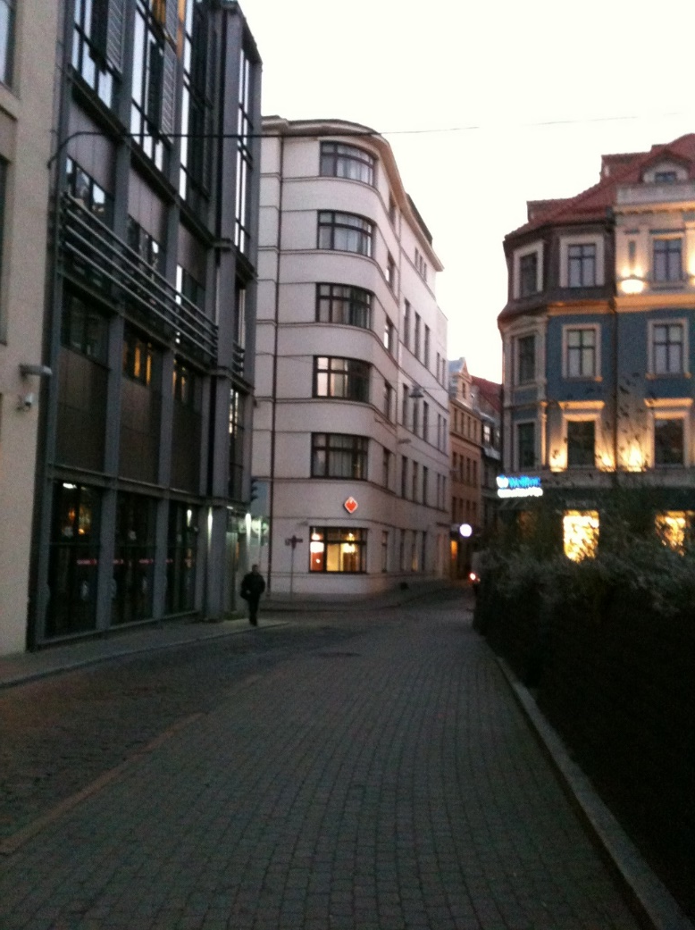
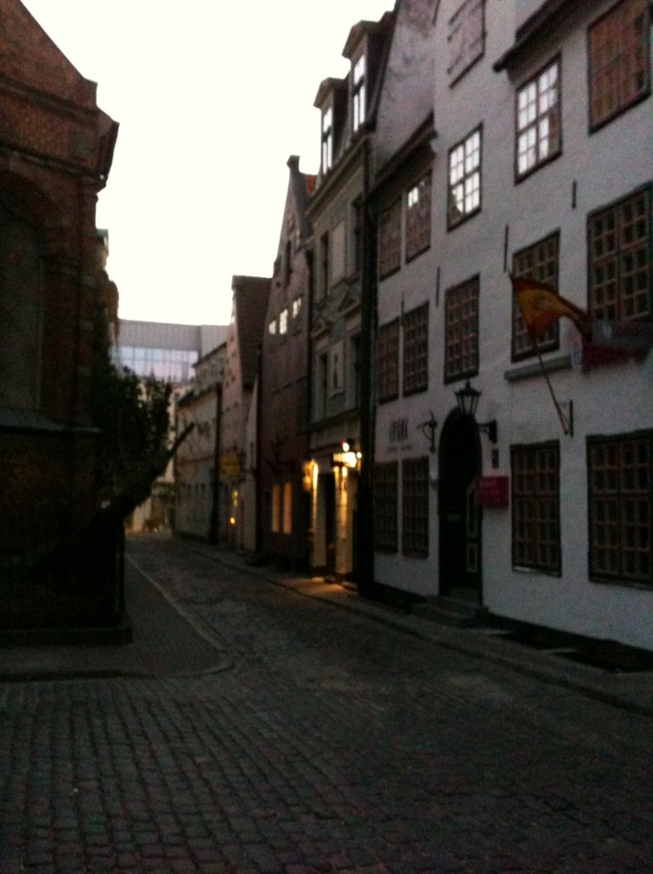
⇑Va_{10m}
Va_{30m}
Re_{10m}
Va_{3m}
Re_{1m}
⇑Re_{10m}
Va_{30m}
Re_{10m}
Re_{3m}
Re_{1m}
⇑Va_{10m}
Va_{30m}
Re_{10m}
Va_{3m}
Va_{1m}
⇑Va_{10m}
Va_{30m}
Va_{10m}
Va_{3m}
Va_{1m}

Slide 23
Variety in modes, orders, levels and layers
modes | orders | levels | layers
probable | intention | … | managerial
possible | function | 1mm | cultural
imaginable | structure | … | economic
 | form | 1m | technical
desirable | content | 3m | biological
 |  | 10m | physical
 |  | …

Slide 24
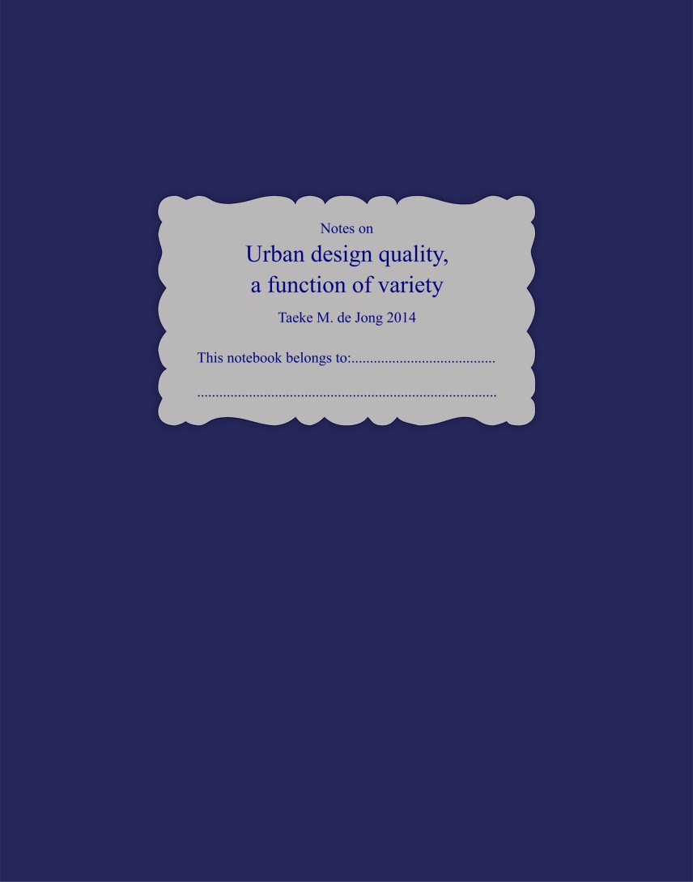
Further reading

