Slide 1
Urban design involves more than probable knowledge, cognition, complexity, self-organisation or abduction.
Design generates improbable possibilities.
Taeke M. de Jong
http://taekemdejong.nl
taekemdejong@outlook.com

Slide 2
Your questions? My answers
Imagining a large succession of actions is a basic human capability. It is supposed in any design. The initial conditions, however, and the new ones to be generated through design, are domain-dependent.
Urban designers design across scales. The implication of moving across scales is, that every change in the level of scale with at most a factor 3, changes the required mode of thinking. You cannot keep the same suppositions. You should change scale sensitive suppositions about intentions, functions, structures, forms and contents (orders of design), and you should change suppositions about management, culture, economy, technology, biology and physics (layers of design).

Slide 3
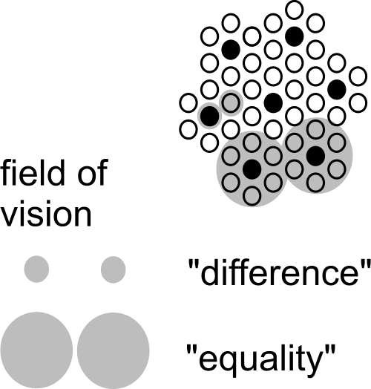
A scale paradox
A (linear) factor 3 larger focus may change your conclusion into the opposite
http://www.taekemdejong.nl/Publications/2008/Scale articulation.doc

Slide 4
Your questions? My answers
The future is unpredictable in nature. Humans generate predictions, which are probable futures. Designers, however, should also take desirable and possible futures into account. The futures that are probable, but not desirable are your field of problems. The futures that are desirable, but not probable are your field of aims. The core of design is, to generate conditions making them possible.
‘Academic urban design’ should change some usual suppositions. The impact on practice and education will be: a more precise distinction in modes of thinking, in levels, layers, and orders of design, and their hidden suppositions.
In the following I will explain some background of these answers.

Slide 5
Some definitions
Condition = an environmental component making an event possible.
Cause = the last added condition making an event actual.
Supposition = a preceding condition making something (im)possible to imagine.
Human = able to imagine a larger sequence of actions than other animals.
Art = generating and expressing imaginations.
Culture = a set of shared conditions and suppositions (including images).
Knowledge = a set of tested suppositions.
Science = testing, generalizing, and changing suppositions.
Design = generating (not generalizing!) new conditions (including suppositions).

Slide 6
Knowledge (the object of ‘cognitive science’) supposes truth
‘Truth’ supposes an ‘equality’ between an expression and a fact.
But which kind of ‘equality’ is this?
‘Similar’ facts may be generalised into ‘knowledge’ through induction.
How many ‘similar’ facts make an expression ‘true’ for any other ‘similar’ case?
Knowledge can be applied to ‘similar’ cases through logical deduction.
But when are cases really ‘similar’?
I will not answer these questions.
They depend on the many hidden suppositions of ‘equality’ and ‘similarity’.
Instead, I will start with the nature of logical deduction.

Slide 7
Logical deduction transfers truth-values.
MODUS PONENS
If I am in Delft, then I am in The Netherlands. Antecedent => Consequence
Well, I am in Delft. A true, so
So, I am in The Netherlands C true
MODUS TOLLENS
If I am in Delft, then I am in The Netherlands. A => C
Well, I am not in the Netherlands. ~C (not true), so
So, I am not in Delft. ~A (not true)
Mark the logically allowed sequences AC and ~C~A

Slide 8
Abduction does not transfer truth-values
ABDUCTION
If I am in Delft, then I am in The Netherlands. A => C
Well, I am in the Netherlands. C true, so
So, I am in Delft. A is not true, but possible.
If you raped her, then I will find your DNA. A => C
Well, I found your DNA. C true, so
So, you raped her. A is not true, but possible.
Mark the sequences CA

Slide 9
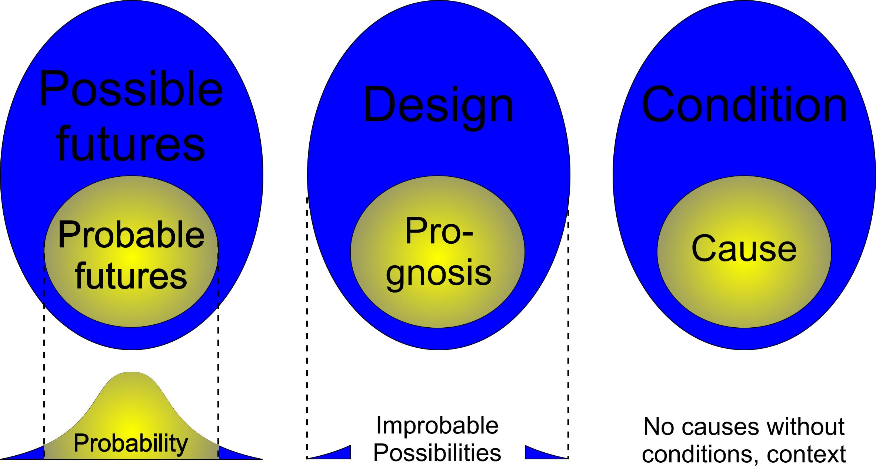
Design supposes possibility (not only truth or probability)

Slide 10
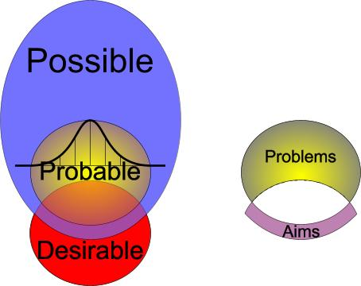
Three modes of reasoning involved in design
Conditional logic
Truth-based logic
Intentional logic

Slide 11
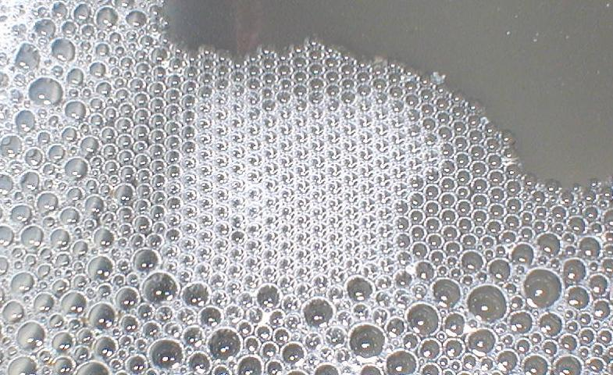
‘Complexity’ may produce a regular pattern
not a structure or an organisation;
probable, not necessarily desirable;
at one level of scale, or repeating equal rules at every level of scale;
not robust for other possibilities;
under specific and strict conditions.
But, design creates new conditions in order to provide new possibilities.
Ecology is an empirical (probability-based) study of self-organisation in systems of living organisms. However, any ecosystem appears to be different, dependent on many local conditions and the possibilities of many differently rule-based species accidentally present. Its pattern emerges trough occasional task-division (organisation), and connections or separations (structure), different at different levels of scale.

Slide 12
Design is shaping new conditions
Condition = an environmental component making an event possible.
Conditions are possible through underlying conditions, for example:
condition C is not possible without condition B, and B not without A.
Humans are able to imagine a large sequence of conditions.
Suppositions are conditions preceding an imagination, for example:
You cannot imagine Culture without life, and no Biotics without Abiotics.
C supposes B supposes A, or in short: C ⇓ B ⇓ A.

Slide 13
Conditional logic determines possibilities
There are many (hidden) suppositions involved in any imagination.
Some tacit suppositions may block imagining design possibilities.
In ‘cognitive science’, a set of suppositions is called a ‘frame’.
‘Reframing’ is skipping blocking suppositions and adding new ones.
Conditional logic determines the necessary sequence of suppositions.
My first (rough) study of conditional logic was Jong(1992)Kleine methodologie voor ontwerpend onderzoek(Meppel)Boom

Slide 14
Some conditional sequences relevant for design
Modes: probability ⇓ possibility
Orders: intention ⇓ function ⇓ structure ⇓ form ⇓ content
Levels: … 1m ⇓ 10m ⇓ 100m ⇓ 1 000m ⇓ 10 000m …
Layers: management ⇓ culture ⇓ economy ⇓ technology ⇓ biology ⇓ physics
Within any of these words you can ‘reframe’ their hidden suppositions.

Slide 15
Hertzberger’s method of reframing
Gather many images
Break off the cliché’s
Change the context
Adapt to the actual context
Jong&Voordt eds.(2002)Ways to study and research urban, architectural and technical design (Delft)DUP Science

Slide 16
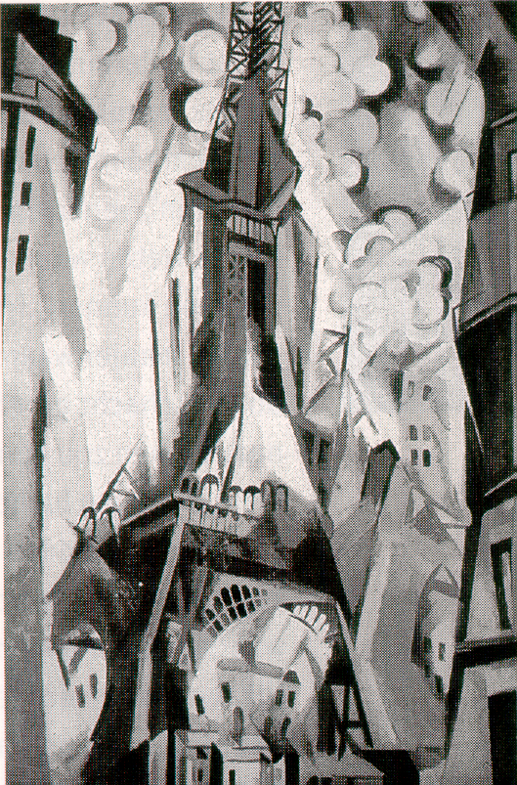
Break off the cliché’s
Robert Delaunay (1913?) Eiffel tower

Slide 17
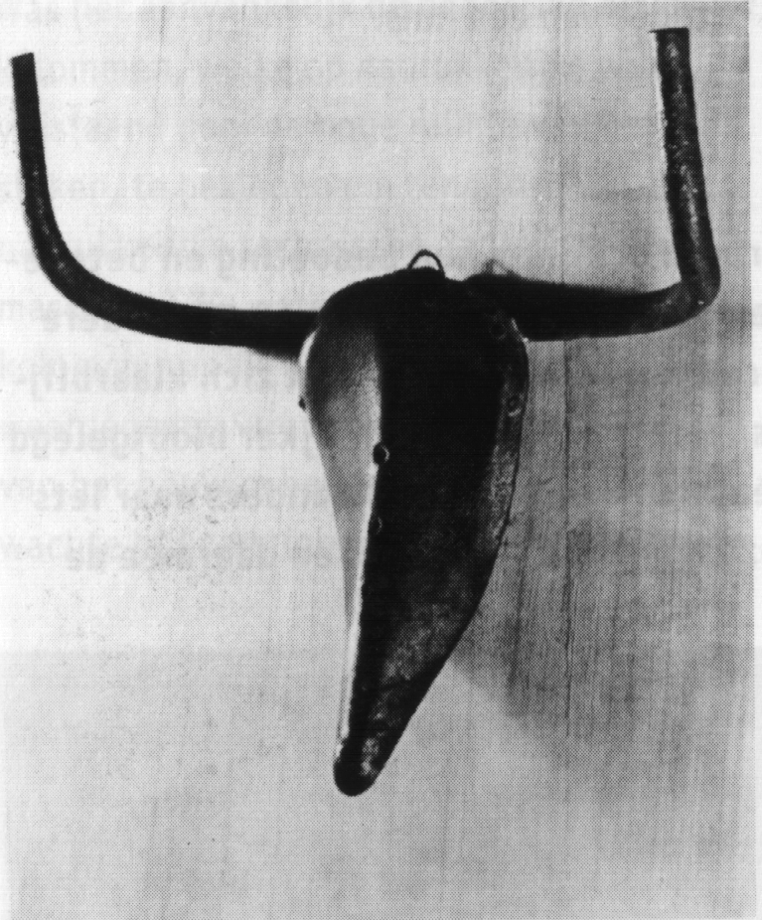
Change the context (set of conditions or suppositions)
For example, change:
scale,
material (content),
dispersion in space (form),
connections and separations (structure), the way it works (function),
its meaning (intention).
Pablo Picasso (1942) Tête de Taureau

Slide 18
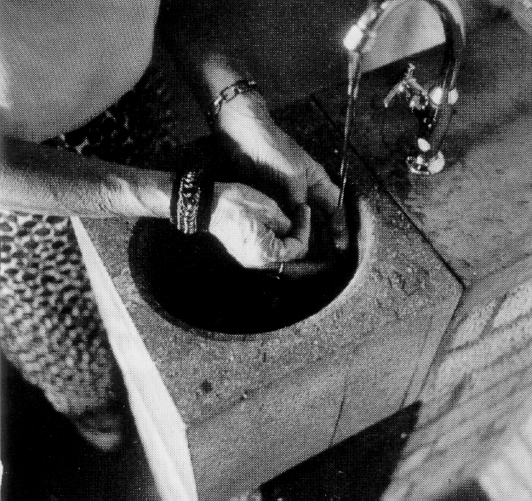
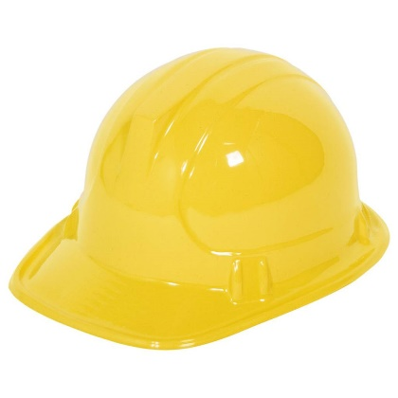
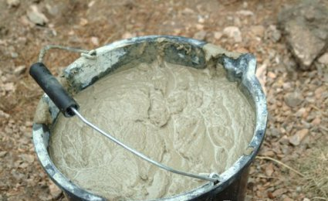
Adapt to the actual context
At last: washbasins forgotten! Hertzberger sees a man passing the window of the construction trailer, and adapts it immediately into an instant design.
+
=
Hertzberger (1970) Washbasin (Apeldoorn) Centraal Beheer

Slide 19
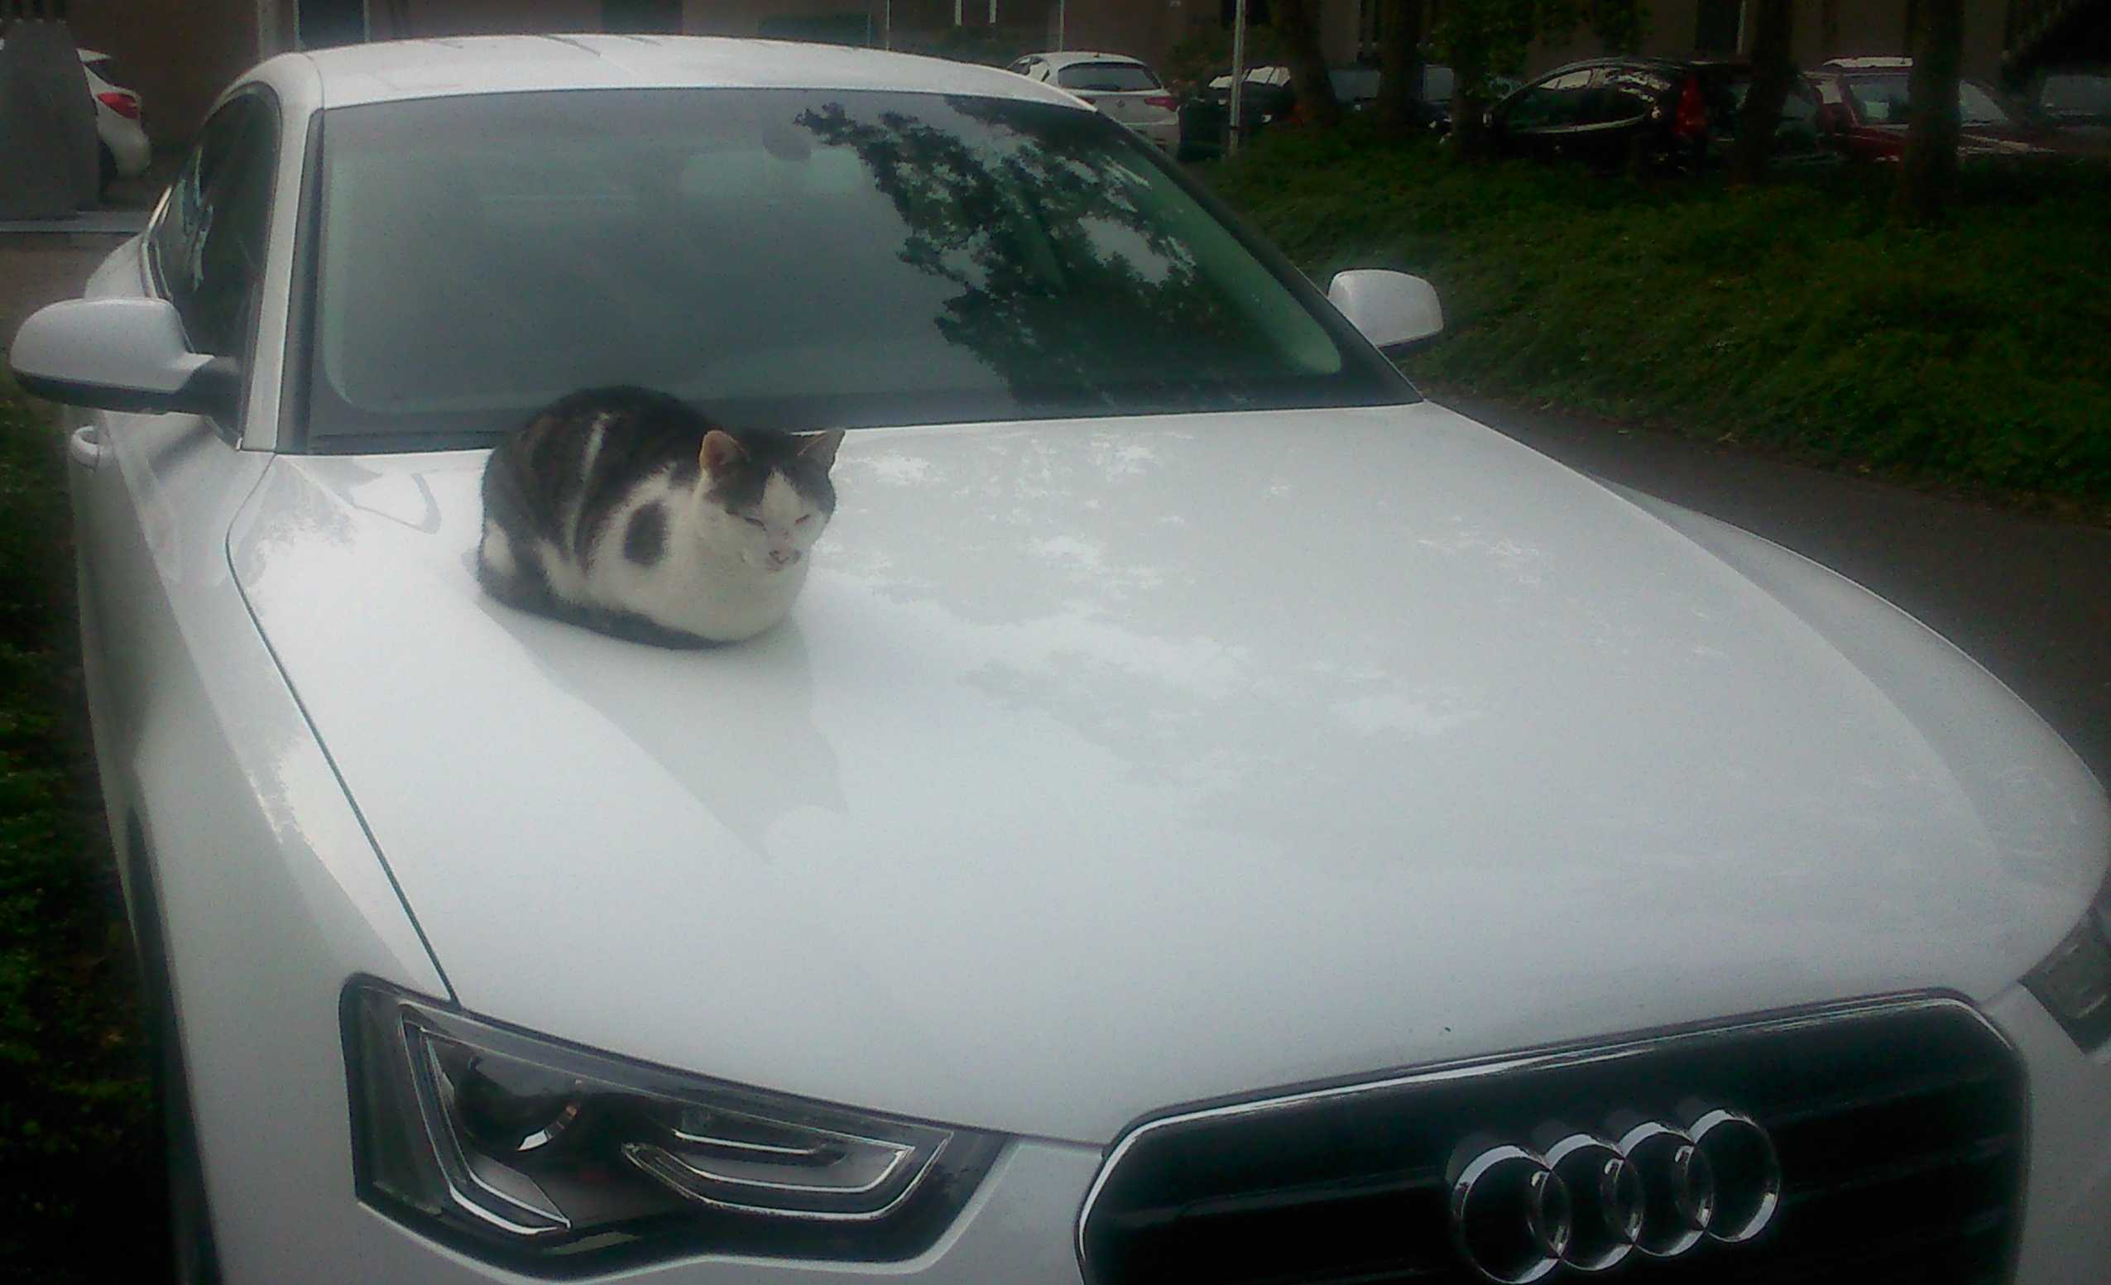
Change your suppositions

Slide 20
AutoCat

Slide 21
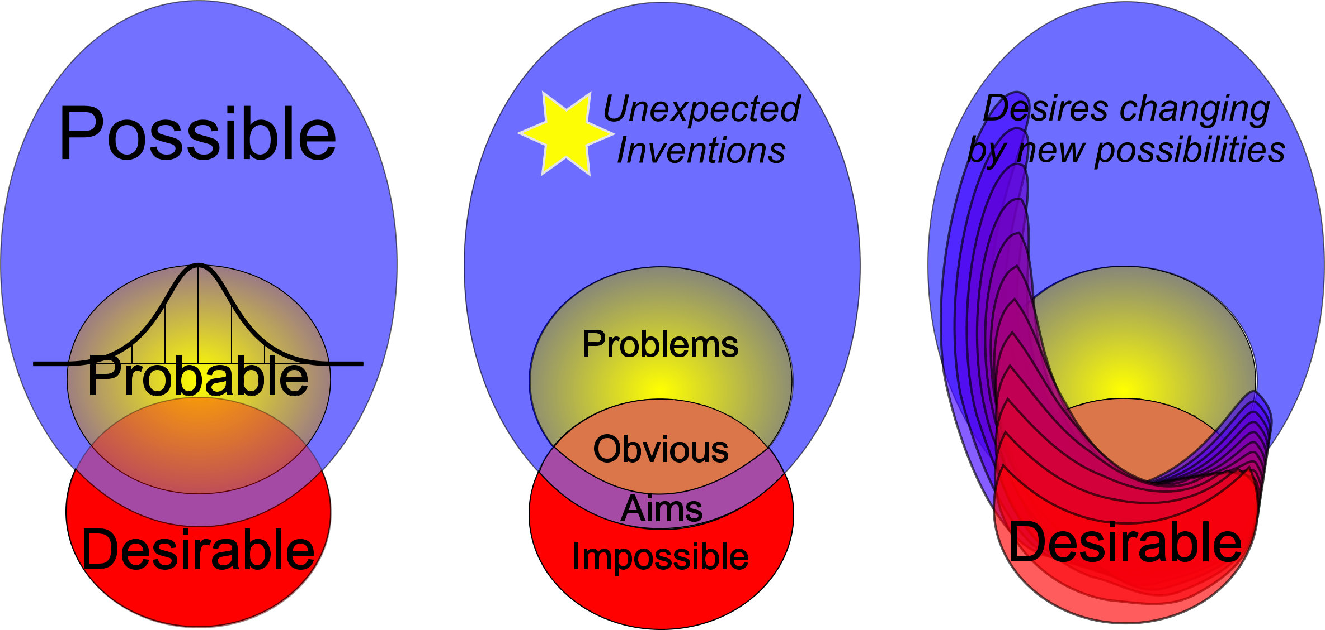
Reframing the third mode: desirable futures

Slide 22
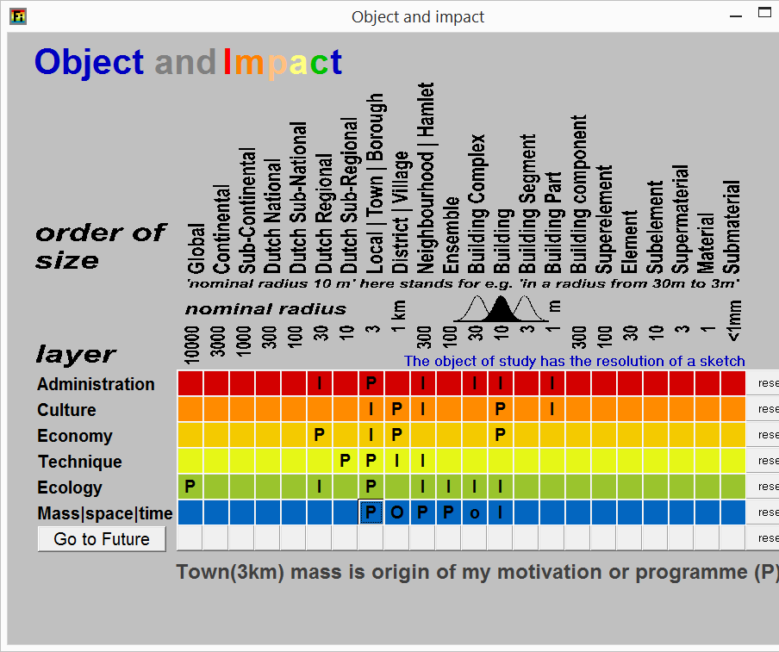
Reframe with desirable future impacts
Ask what users, stakeholders, specialists and other interests expect as desirable (P) and not desirable (I) future impacts,
of a still undetermined object of design (O … o),
for any layer (↓) and at any level of scale (→).
Jong, Taeke M. de (2006) Context analysis (Zoetermeer) concept .doc FutureImpact.zip

Slide 23
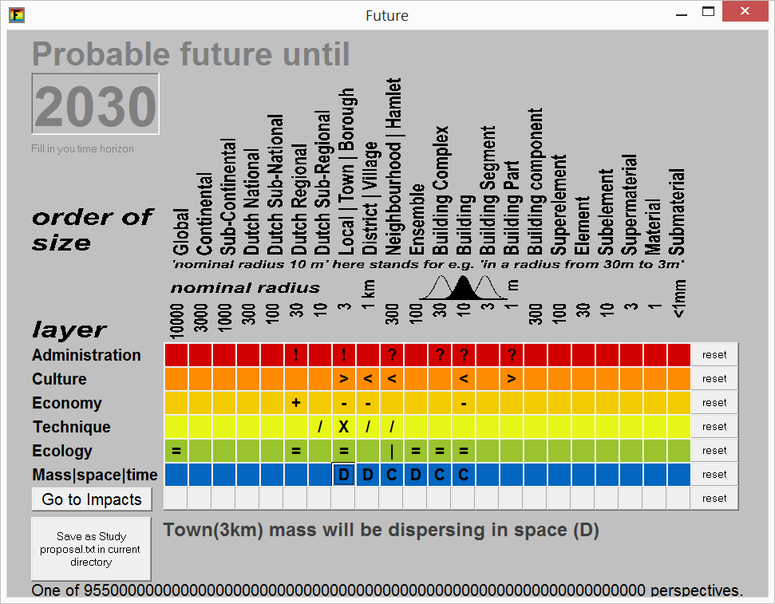
Fix a probable scenario without design impact
Ask them what they would expect without design!
By doing so: fix a teamwise scenario of the context.
Then, derive your field of problems (probable but not desirable) and aims (desirable but not probable):
your program for a design.
Jong, Taeke M. de (2006) Context analysis (Zoetermeer) concept .doc FutureImpact.zip

